Slide 1

Introduction to Operating Systems CS/COE 1550
Fall 2021
Sherif Khattab
ksm73@pitt.edu
(Some slides are from Silberschatz, Galvin and Gagne ©2013)

Slide 2
Announcements
Upcoming deadlines:
12/20 at 5:00 pm: Project 4
Please check Canvas for the rest of the deadlines
Bonus opportunities
Bonus homework
Post-course test
OMET bonus (response rate >= 80%)

Slide 3
Unix Fast File System indexing scheme
protection mode
data
owner & group
data
.
.
.
timestamps
size
data
block count
•
data
•
.
.
.
link count
•
Direct pointers
.
.
.
data
•
•
•
data
•
.
.
.
•
•
single indirect
•
•
data
double indirect
•
•
data
•
•
•
•
.
.
.
triple indirect
•
•
•
inode
•
•
•
data

Slide 4
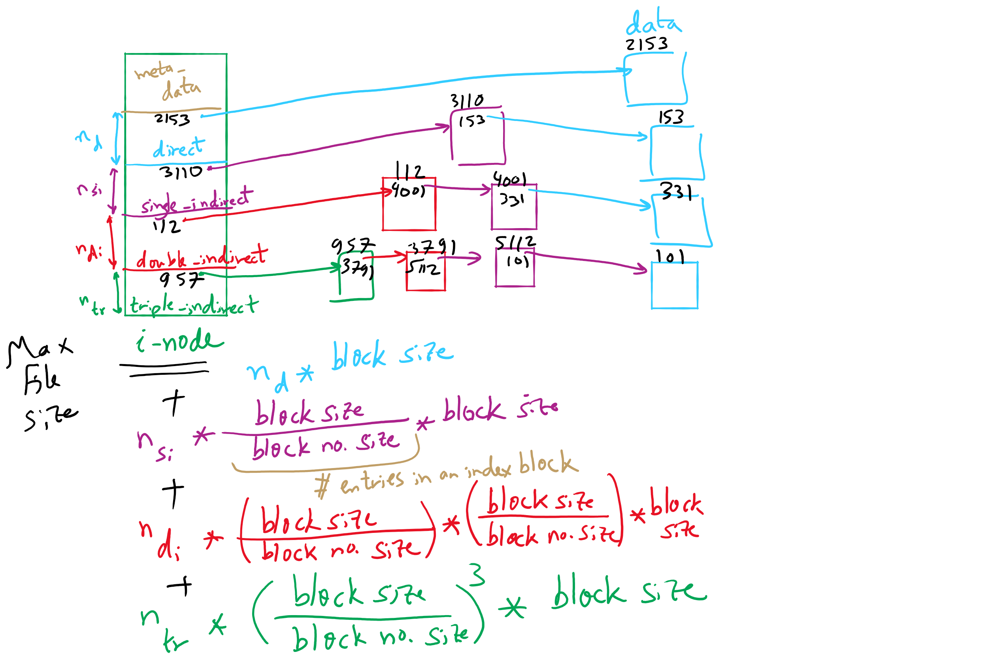
FFS and Max File Size

Slide 5
What’s in a directory?
Two types of information
File names
File metadata (size, timestamps, etc.)
Basic choices for directory information
Store all information in directory
Fixed size entries
Disk addresses and attributes in directory entry
Store names & pointers to index nodes (i-nodes)
attributes
games
attributes
games
mail
attributes
mail
attributes
news
attributes
news
attributes
research
attributes
research
Storing all information in the directory
Using pointers to index nodes
attributes

Slide 6
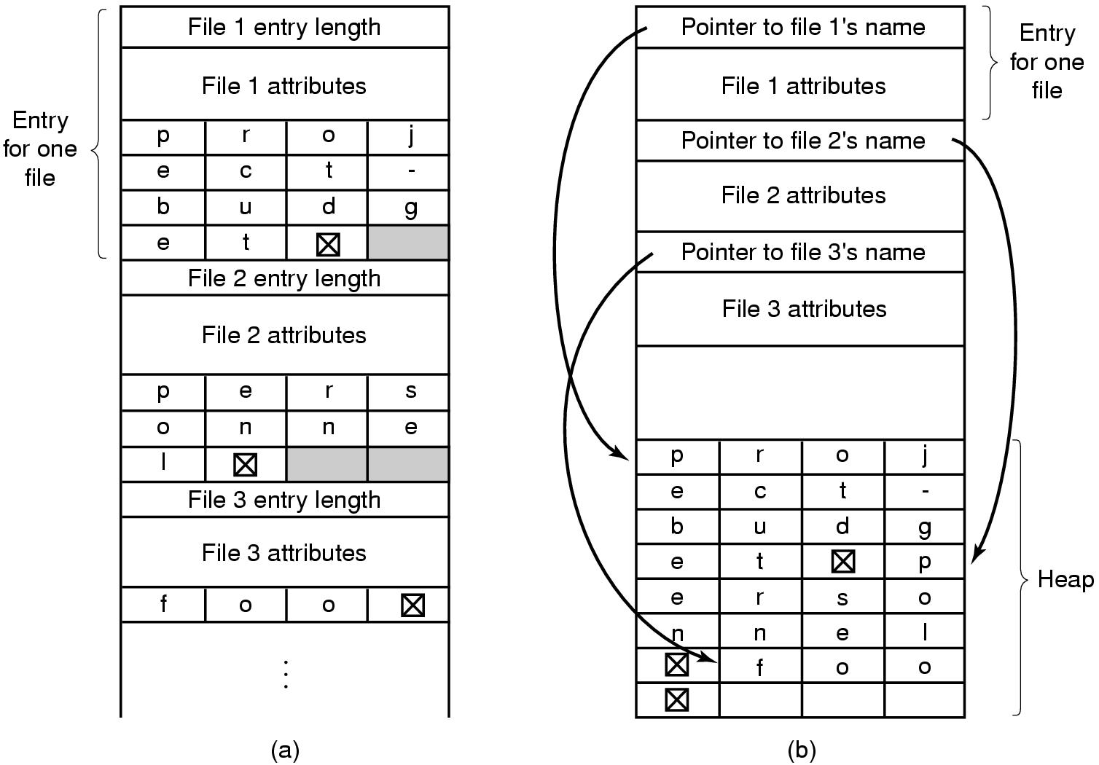
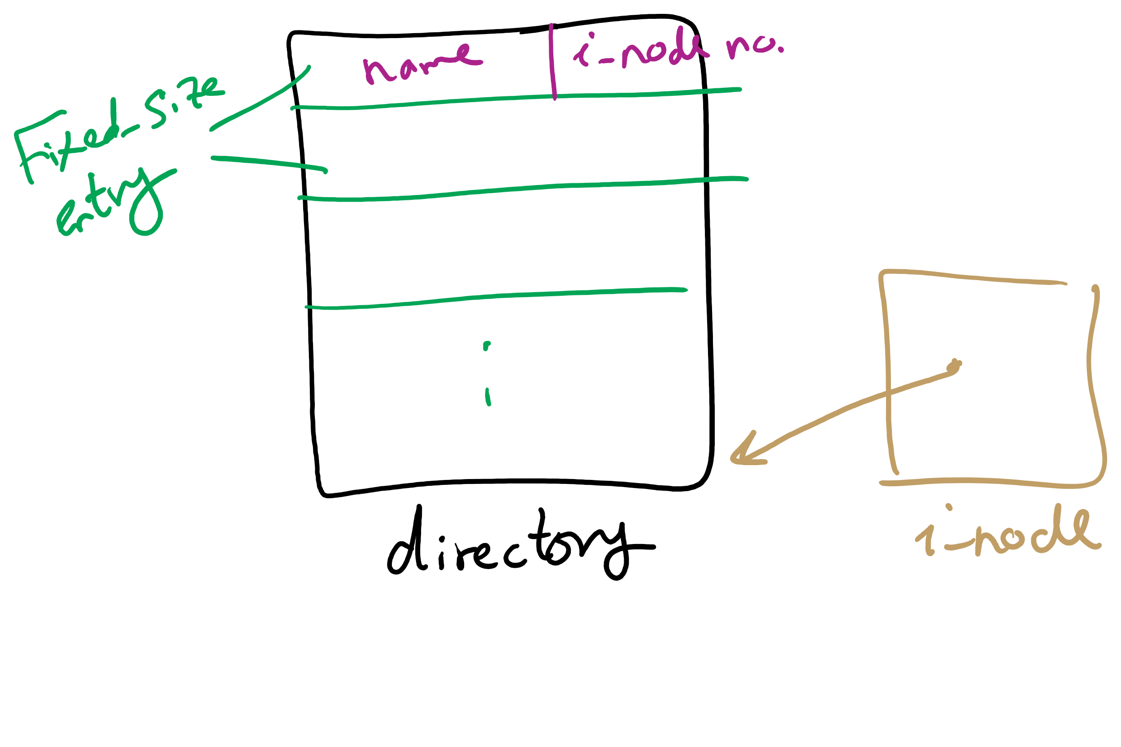
Handling long file names in a directory

Slide 7
Directories in FFS
Directories in FFS are just special files
Same basic mechanisms
Different internal structure
Directory entries contain
File name
I-node number
Other Unix file systems have more complex schemes
Not always simple files…
Directory
inode number
record length
name length
name
inode number
record length
name length
name

Slide 8
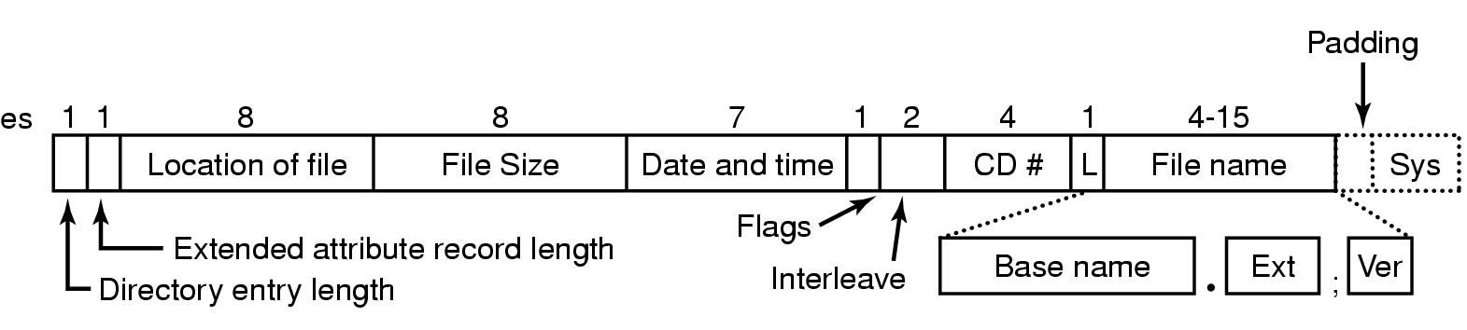
CD-ROM file system

Slide 9
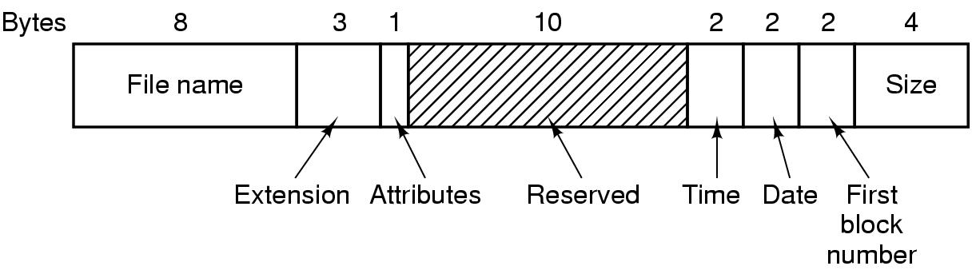
Directory entry in MS-DOS

Slide 10
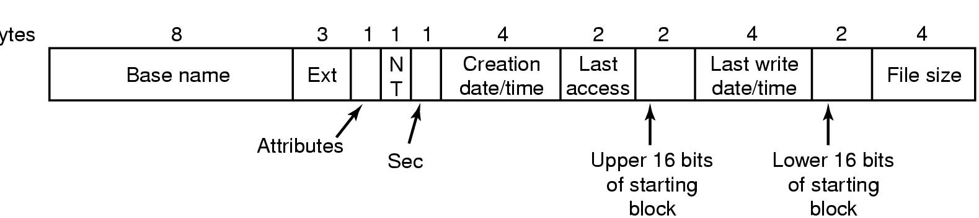
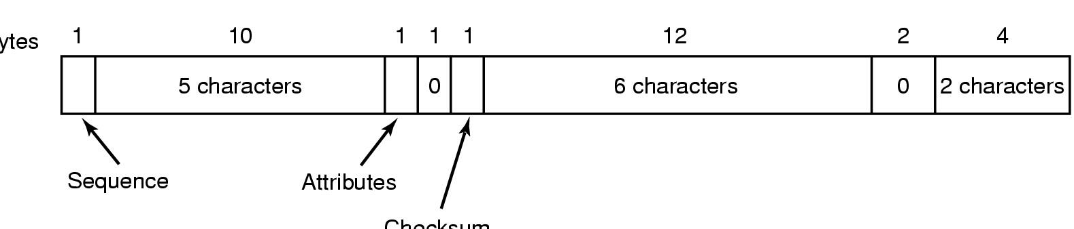
FAT32 Directory and Filename
Bytes
Checksum

Slide 11
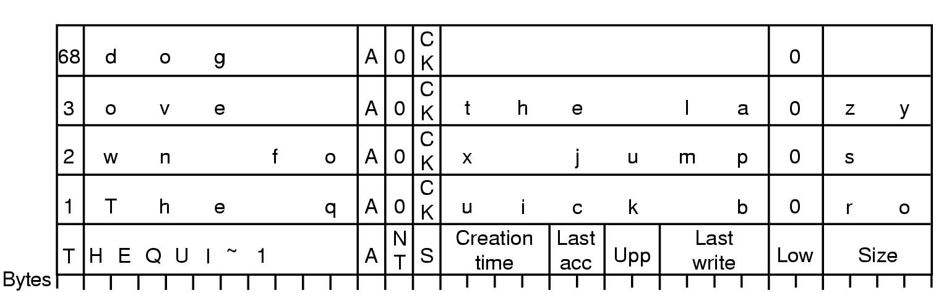
Storing a long name in FAT32
Long name stored in Windows 98 so that it’s backwards compatible with short names
Short name in “real” directory entry
Long name in “fake” directory entries: ignored by older systems
OS designers will go to great lengths to make new systems work with older systems…

Slide 12
Sharing files
Root directory
A
B
C
A
Papers
A foo
A
Photos
B foo
B
Photos
C bar
C foo
C blah
A os.tex
A sunset
A
Family
B lake
A sunset
A kids
? ???

Slide 13
Solution: use links
A creates a file, and inserts into her directory
B shares the file by creating a link to it
A unlinks the file
B still links to the file
Owner is still A (unless B explicitly changes it)
A
A
B
B
b.tex
b.tex
a.tex
a.tex
Owner: A Count: 1
Owner: A Count: 2
Owner: A Count: 1

Slide 14
Free Block Tracking
10

Slide 15
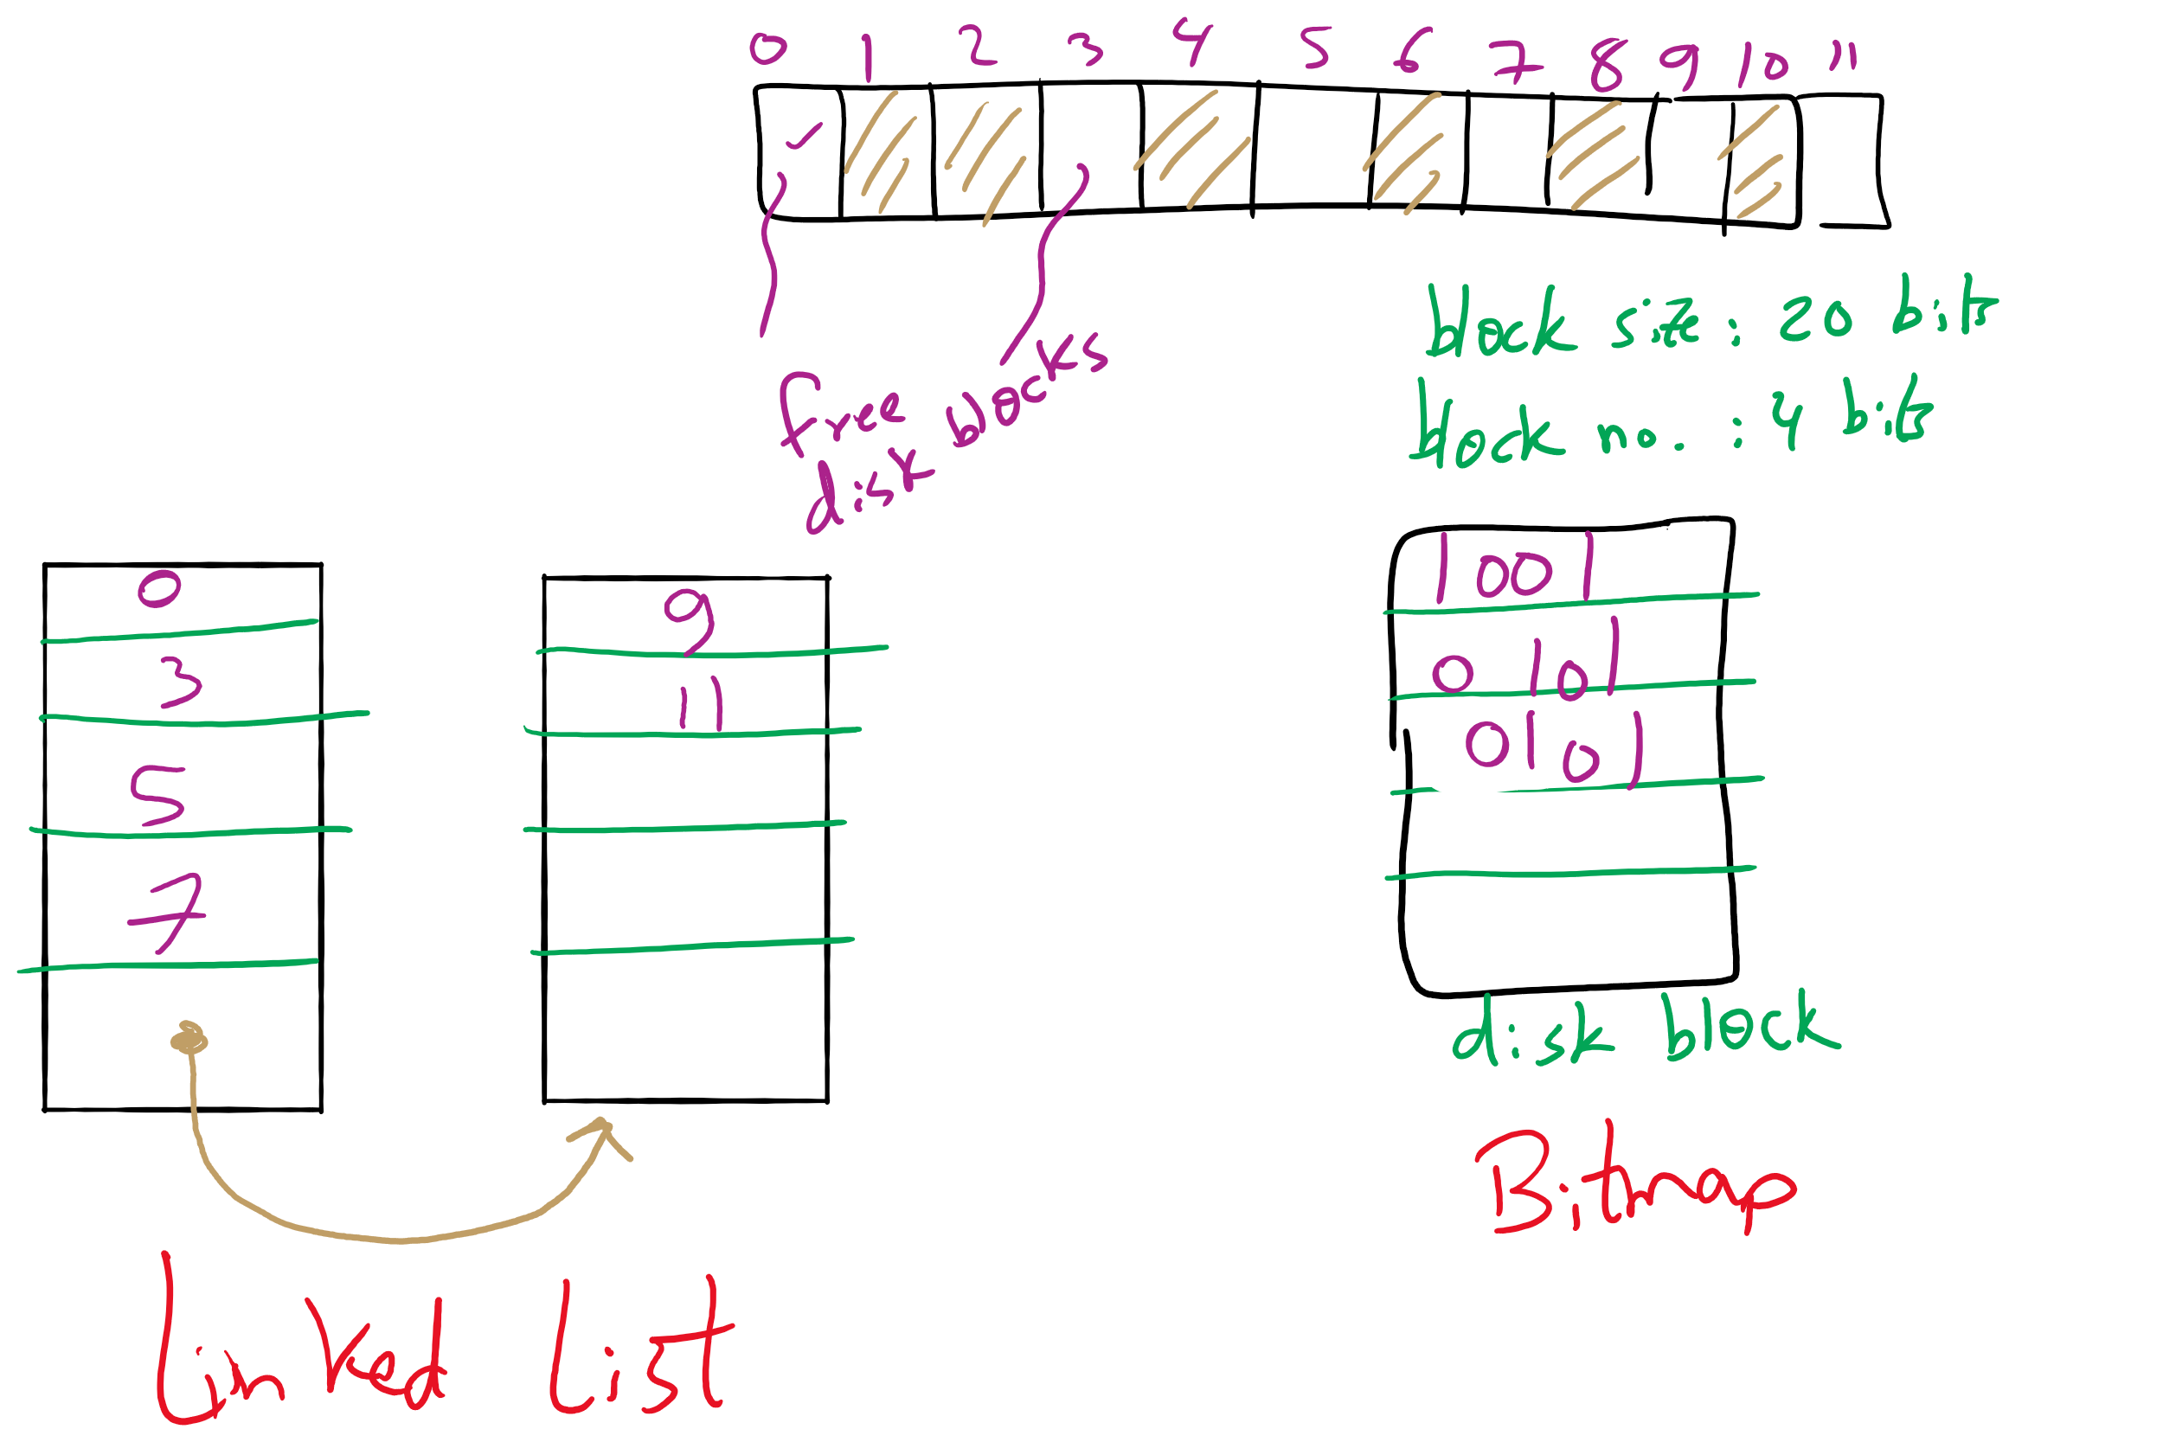
Free Block Tracking Example 1

Slide 16
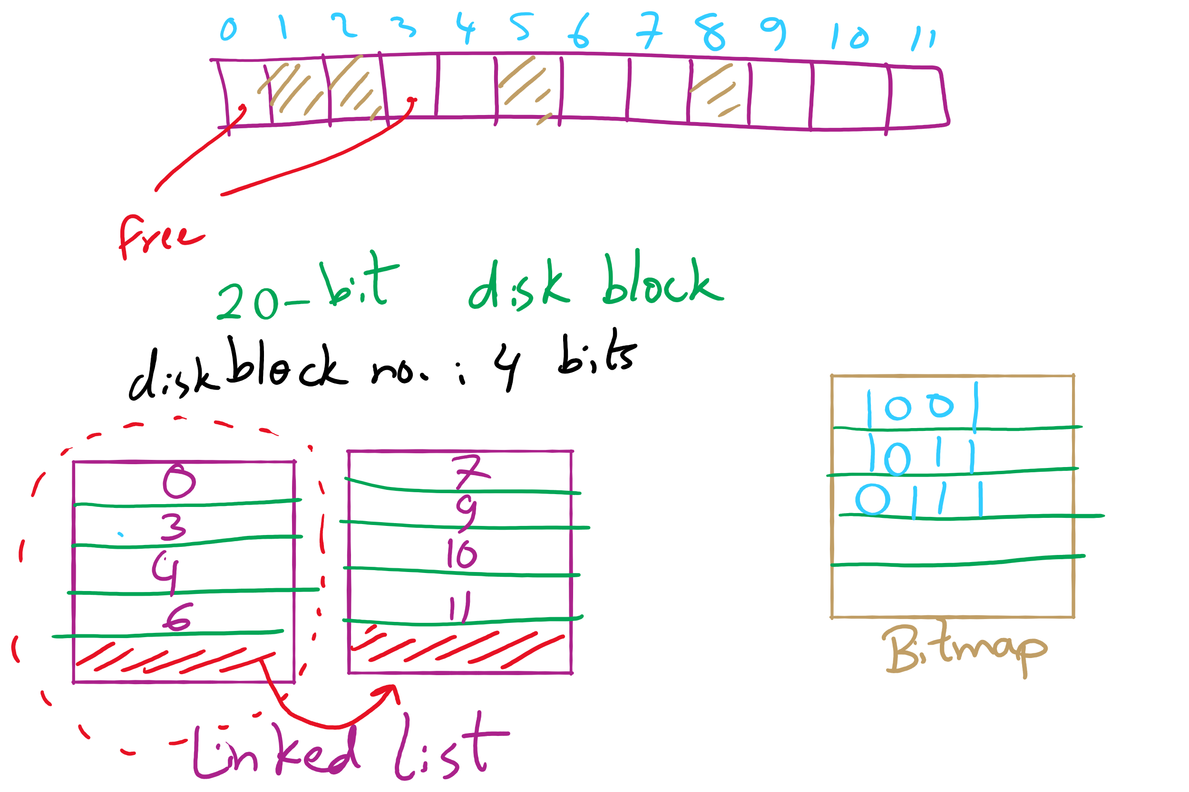
Free Block Tracking Example 2

Slide 17
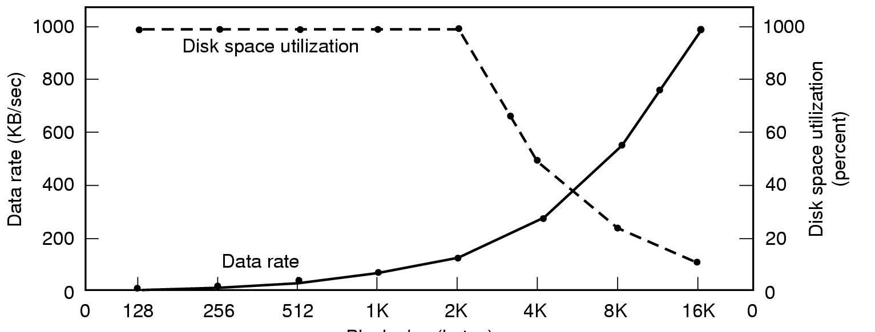
Disk block size
Dark line (left hand scale) gives data rate of a disk
Dotted line (right hand scale) gives disk space efficiency
All files 2KB
Block size

Slide 18
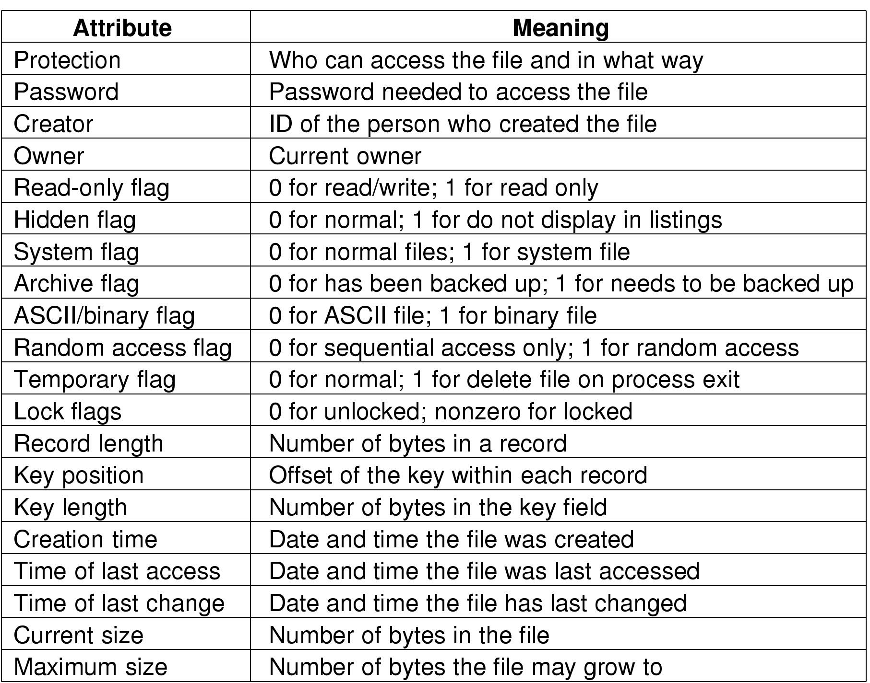
File attributes

Slide 19

Project 4 Hint

Slide 21
FAT-32 Directory Entry

Slide 22
Long File names

Slide 23
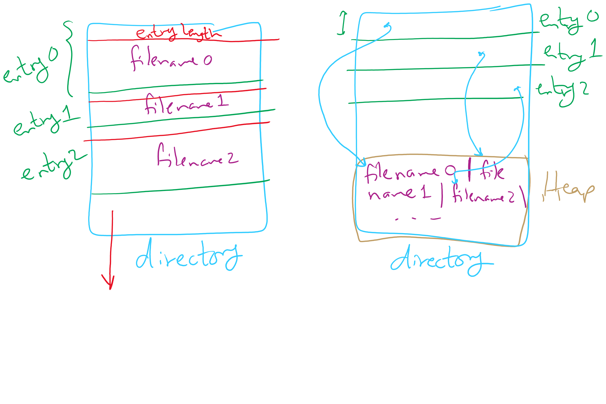
Long File names

Slide 24
Today’s Agenda …
File System Implementation
Optimizing reliability and performance
Low-level device driver issues

Slide 25
Max Partition Size
Block size | FAT-12 | FAT-16 | FAT-32
0.5 KB | 2 MB
1 KB | 4 MB
2 KB | 8 MB | 128 MB
4 KB | 16 MB | 256 MB | 1 TB
8 KB |  | 512 MB | 2 TB
16 KB |  | 1024 MB | 2 TB
32 KB |  | 2048 MB | 2 TB

Slide 26
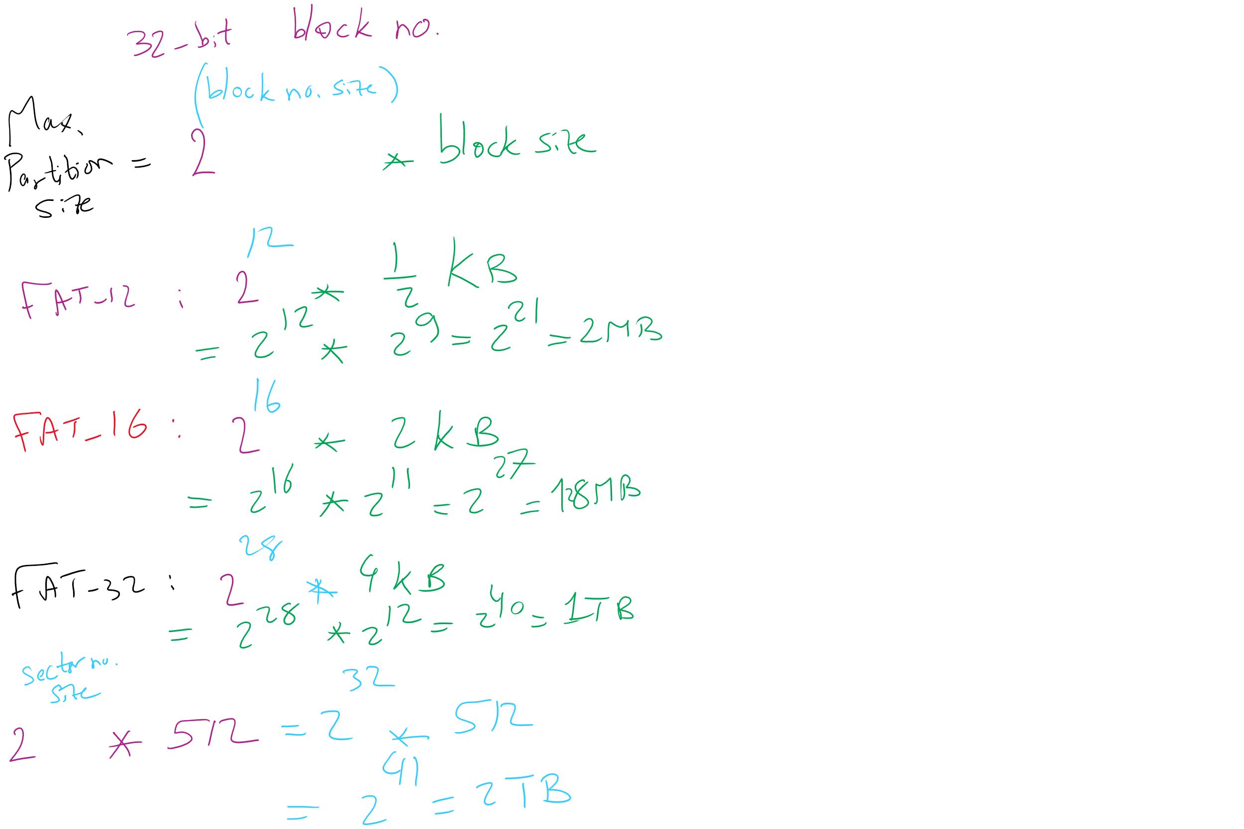
Max Partition Size

Slide 27
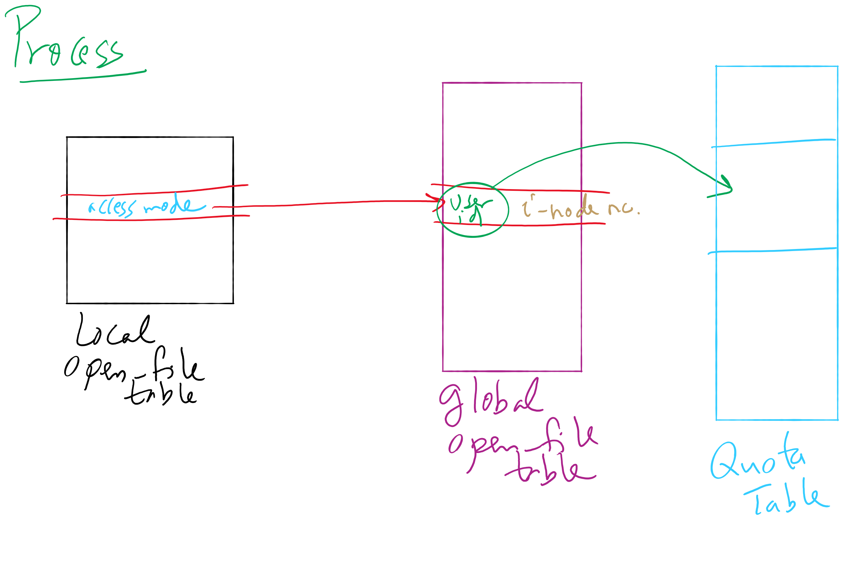
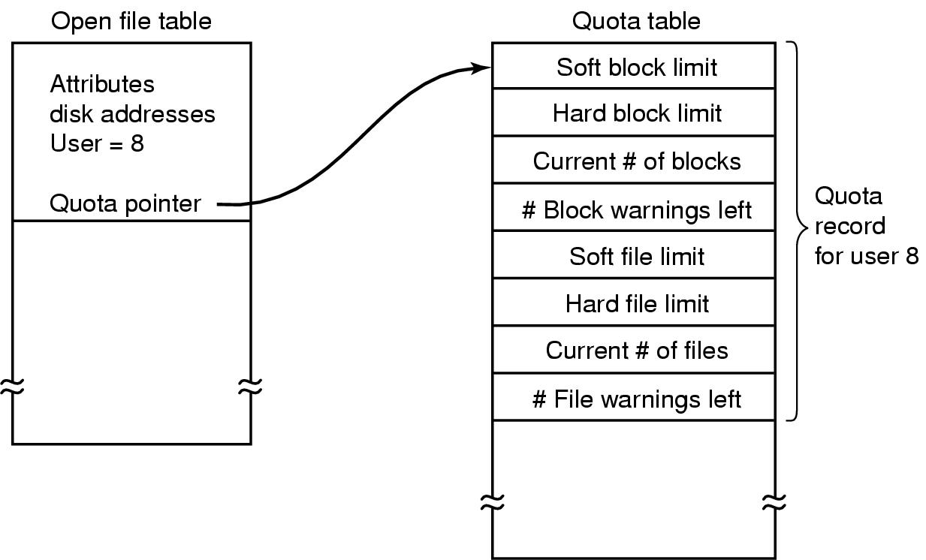
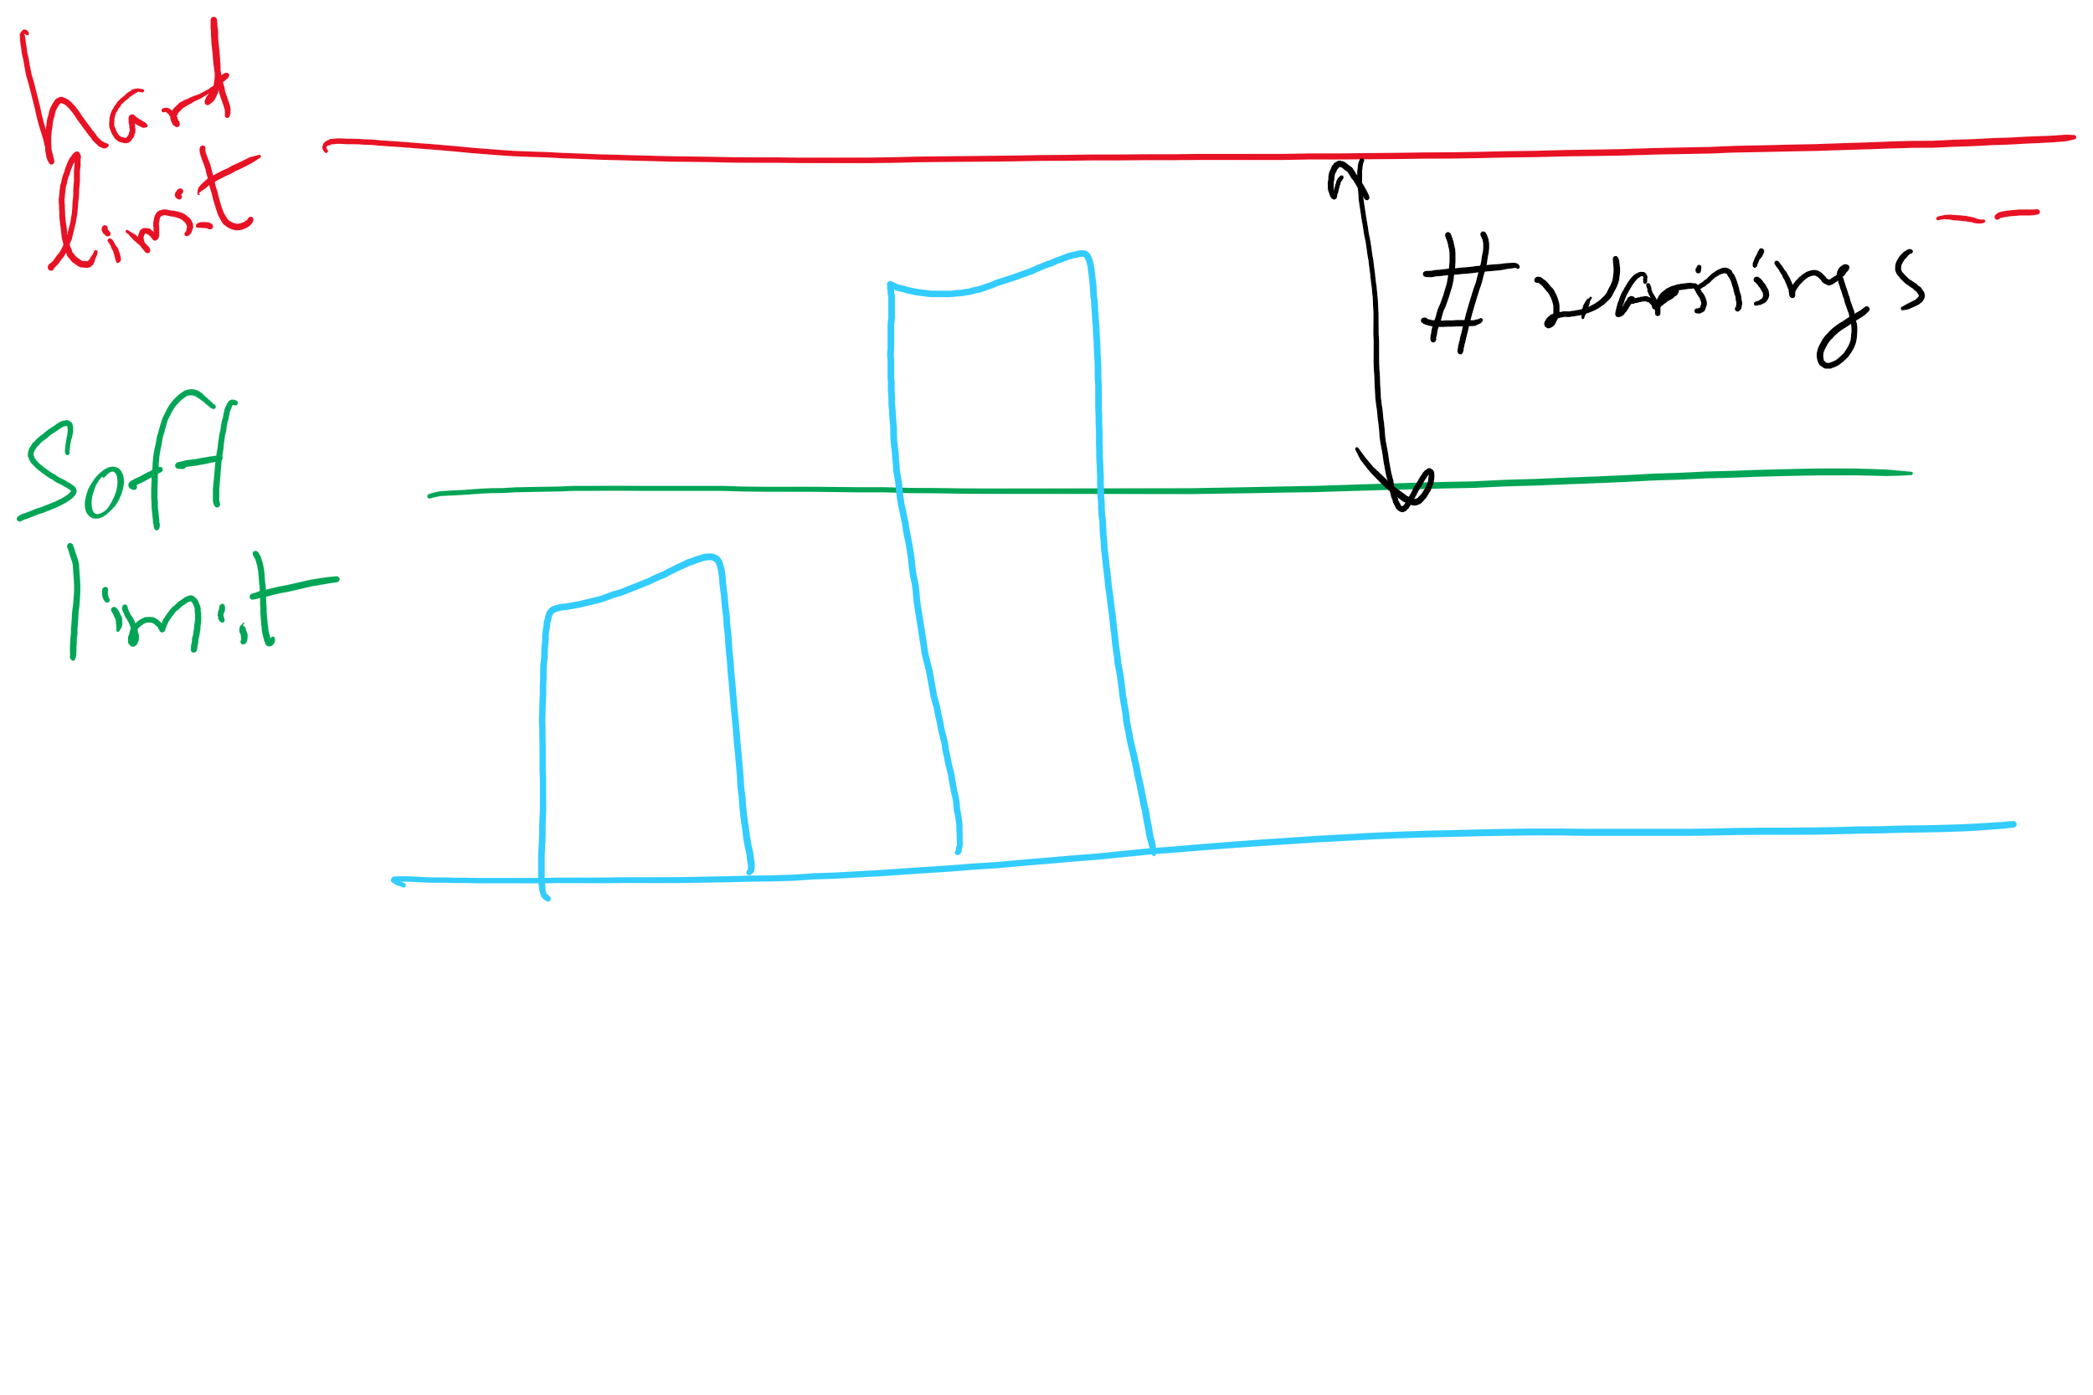
File-related kernel structures: open file tables and disk quotas

Slide 28
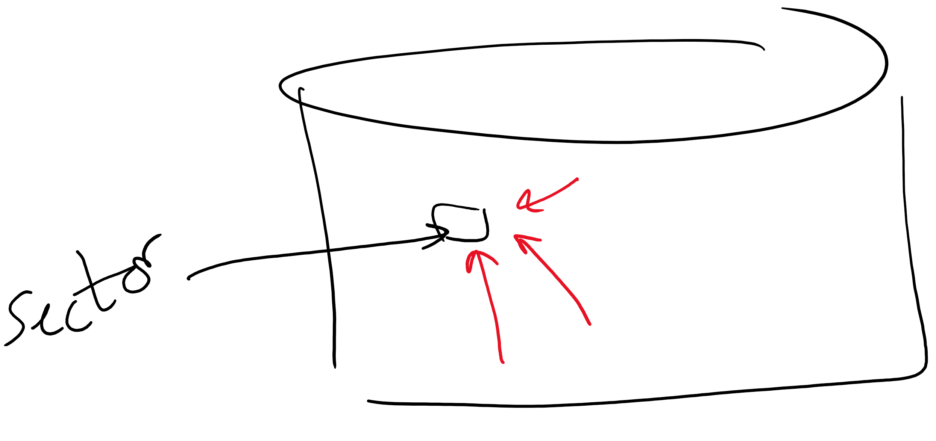
Structure of a disk sector
Preamble contains information about the sector
Sector number & location information
Data is usually 256, 512, or 1024 bytes
ECC (Error Correcting Code) is used to detect & correct minor errors in the data
Preamble
Data
ECC

Slide 29
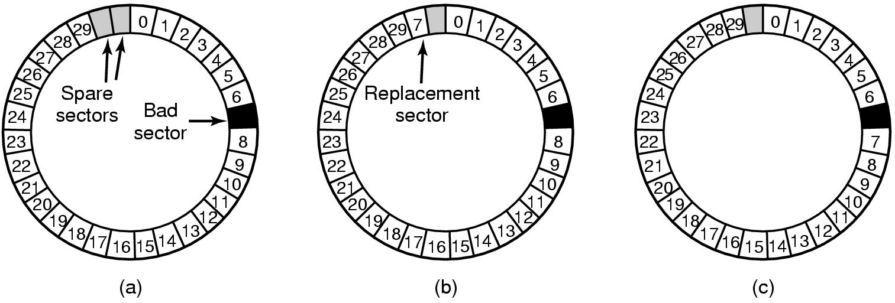
When good disks go bad…
Disks have defects
In 3M+ sectors, this isn’t surprising!
ECC helps with errors, but sometimes this isn’t enough
Disks keep spare sectors (normally unused) and remap bad sectors into these spares
If there’s time, the whole track could be reordered…

Slide 30
RAIDs, RAIDs, and more RAIDs
Stripe
strip
strip
RAID 0
(Redundant Array of Inexpensive Disks
RAID 1
(Mirrored copies)
RAID 4
(Striped with parity)
RAID 5
(Parity rotates through disks)

Slide 31
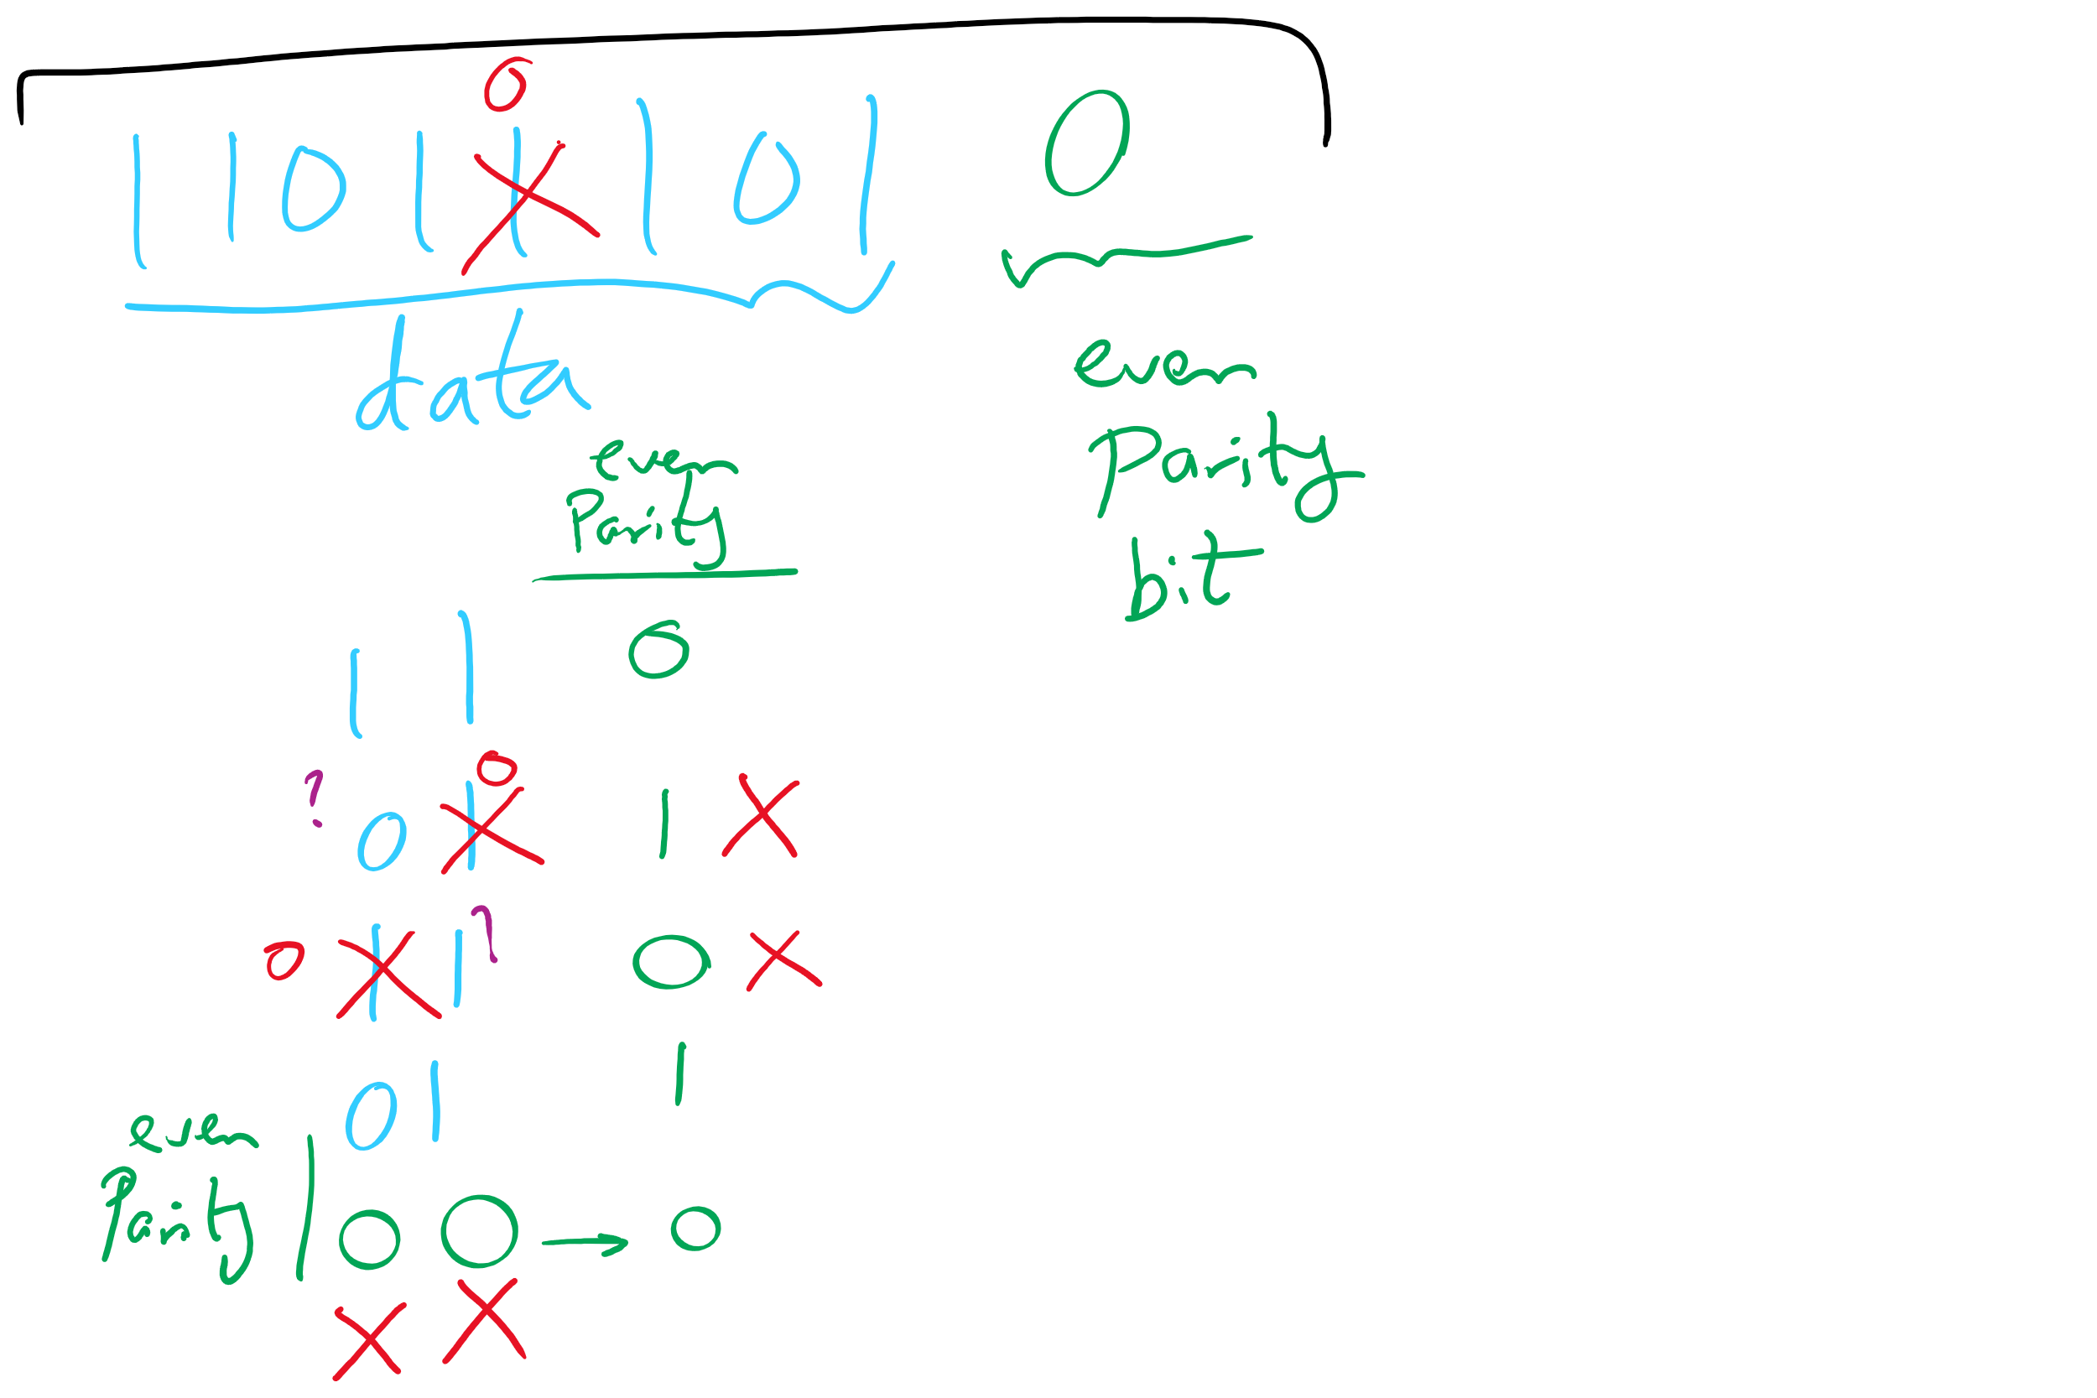
Parity Examples

Slide 32
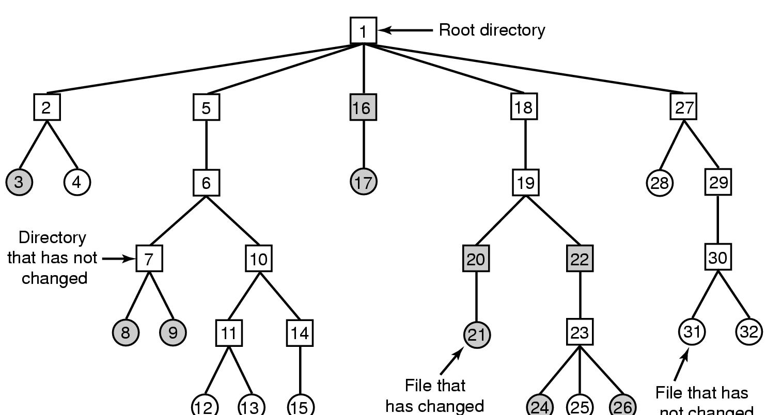
Backing up a file system
A file system to be dumped
Squares are directories, circles are files
Shaded items, modified since last dump
Each directory & file labeled by i-node number
File that has
not changed

Slide 33
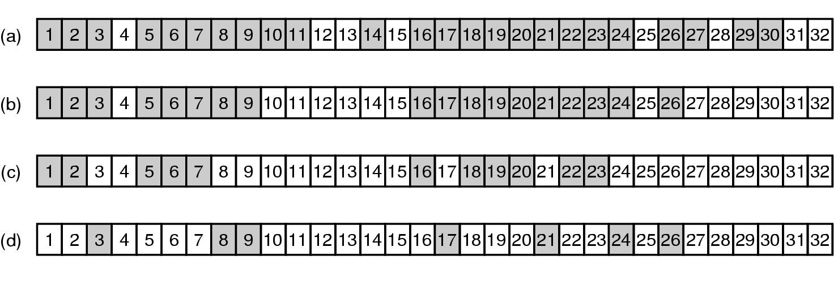
Bitmaps used in a file system dump

Slide 34
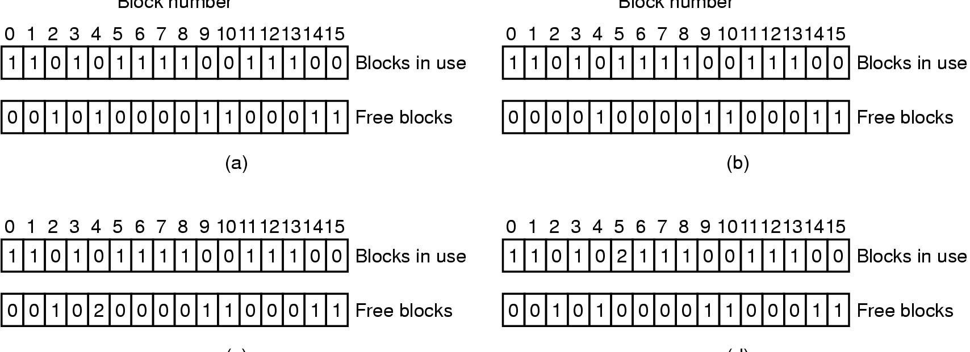
Checking the file system for consistency
Consistent
Missing (“lost”) block
Duplicate block in free list
Duplicate block in two files

Slide 35
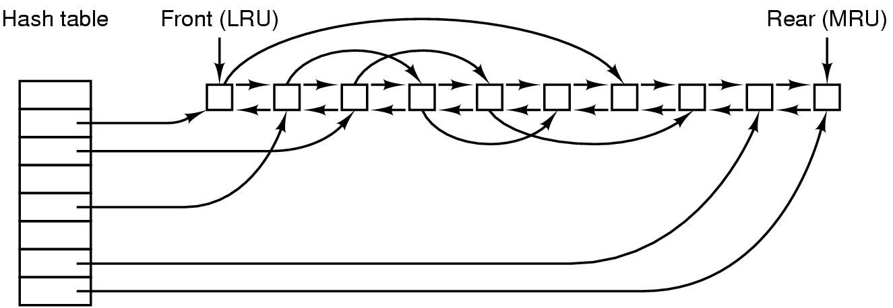
File block cache data structures

Slide 36
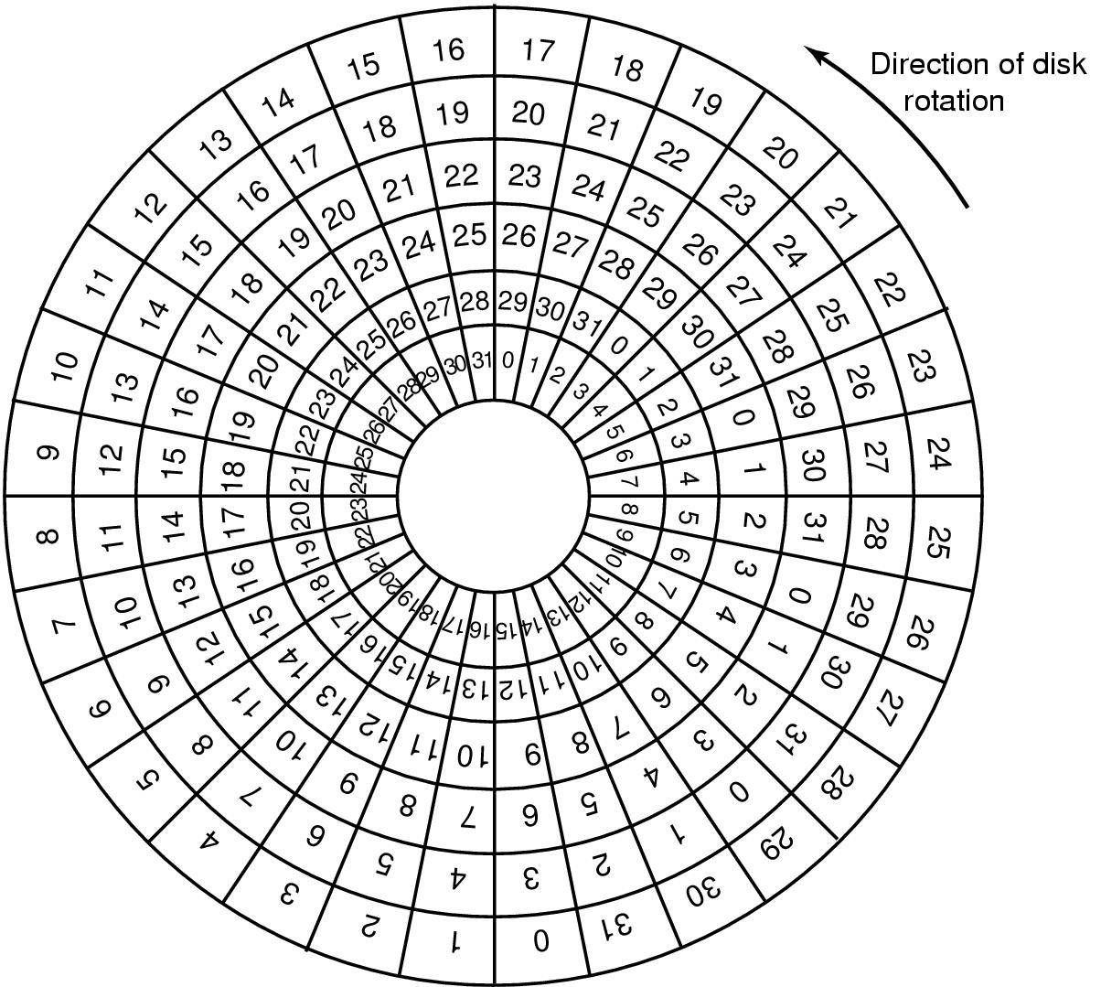
Sector Skew
Sectors numbered sequentially on each track
Numbering starts in different place on each track: sector skew
Allows time for switching head from track to track
All done to minimize delay in sequential transfers

Slide 37
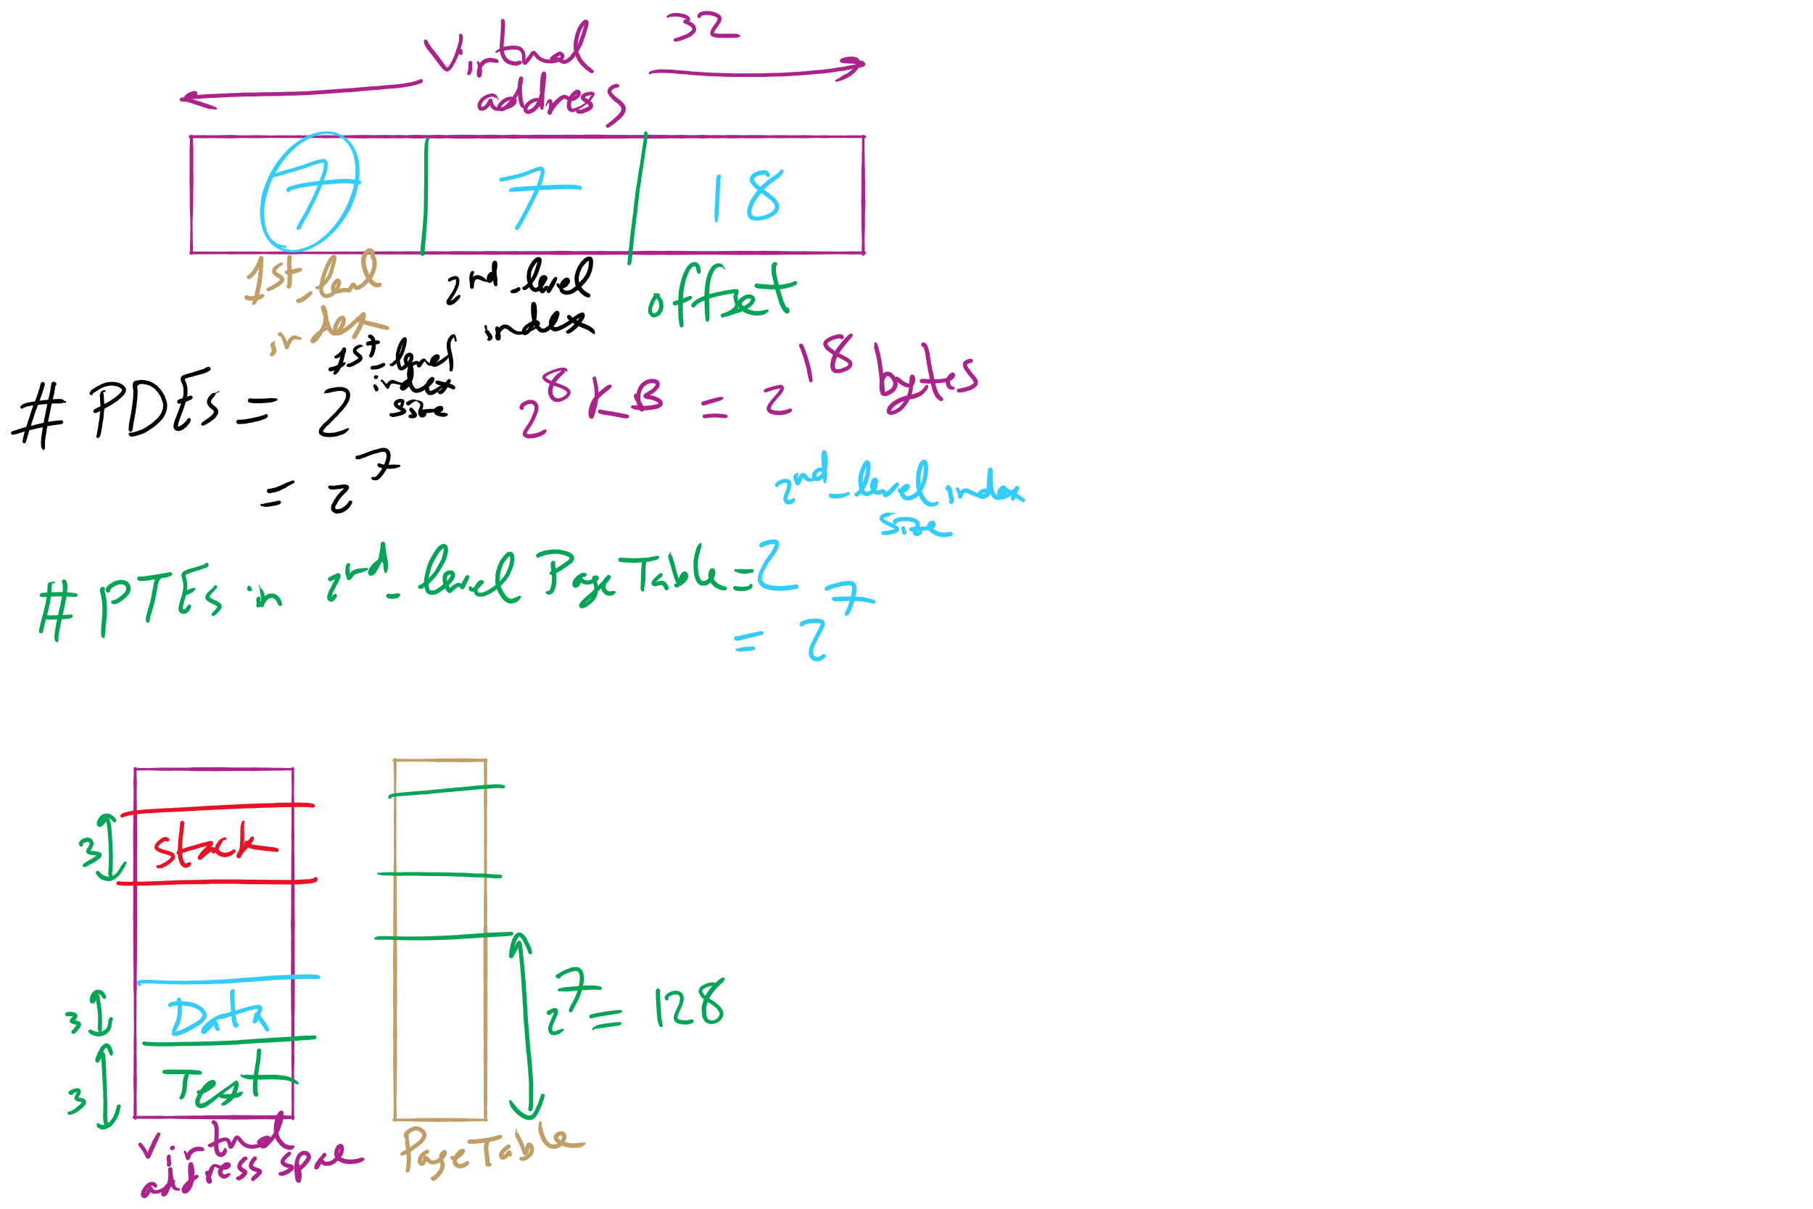
HW 10: Q 2-4

Slide 38
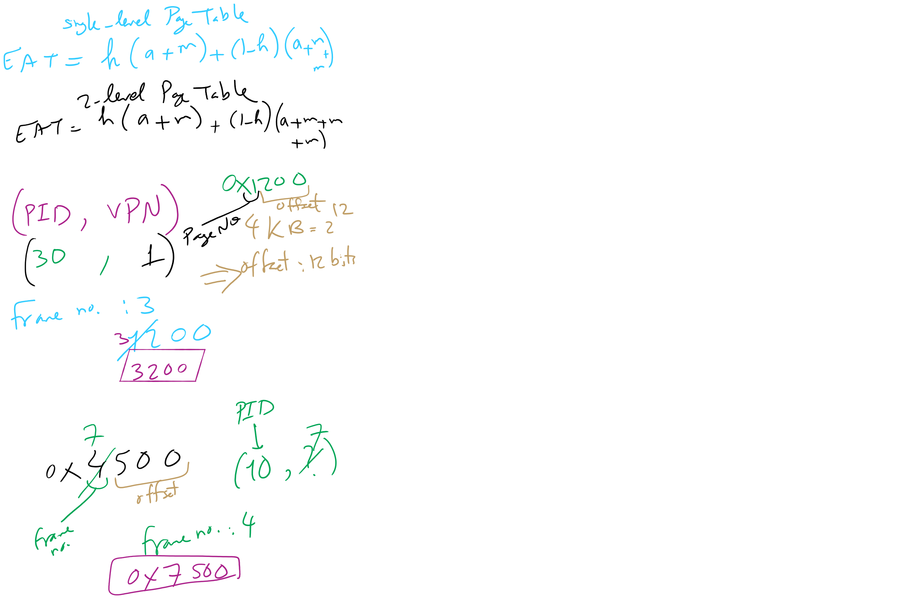
HW 10: Q 10-13

Slide 39
Muddiest Points (1/3)
Project 4
some tips for starting proj4, kinda lost on getting it started
More about implementing Project 4 functions
Hw 11
questions 2 and 3
8,9,10,11
Lab 5
are we supposed to add a new if statement in lab 5 or just modify the if(bn < nindirect) statement? The psuedocode says to modify it but I got a different response on piazza
Quiz 3.
3.1 and 3.3.

Slide 40
Muddiest Points (2/3)
What can cause a disk to go bad? Is it mostly user error or can other events cause them to go bad?
Once a disk sector fails, is it impossible to restore it?
if one file or directory is owned by A and it is copied to B, what's the difference C copied it under B and C copied it under A? and what will happen if somebody unlink it? do they all have revoke access?
what is disk sector
What is the difference between a sector and a partition?
2d parity
Another run through of how the Error Correction Code works.
what exactly is the point of sector skew
I could use another run through of the benefits of skewing and how it works
Disk Block Cache
Could we go over the linked list- looking graph for how the files are connected? It was a bit confusing to me
In the file block cache, why were certain blocks pointing to other blocks in the queue that were not adjacent?

Slide 41
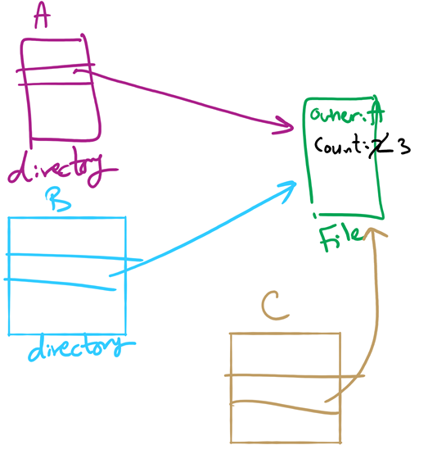
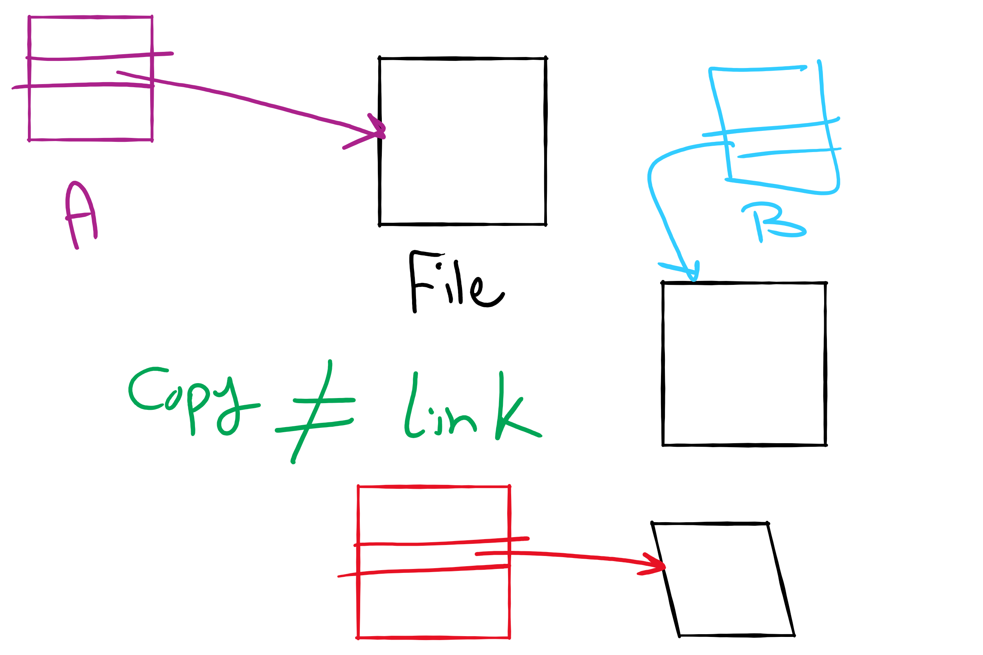
File Linking (left) vs. File Copying (right)

Slide 42
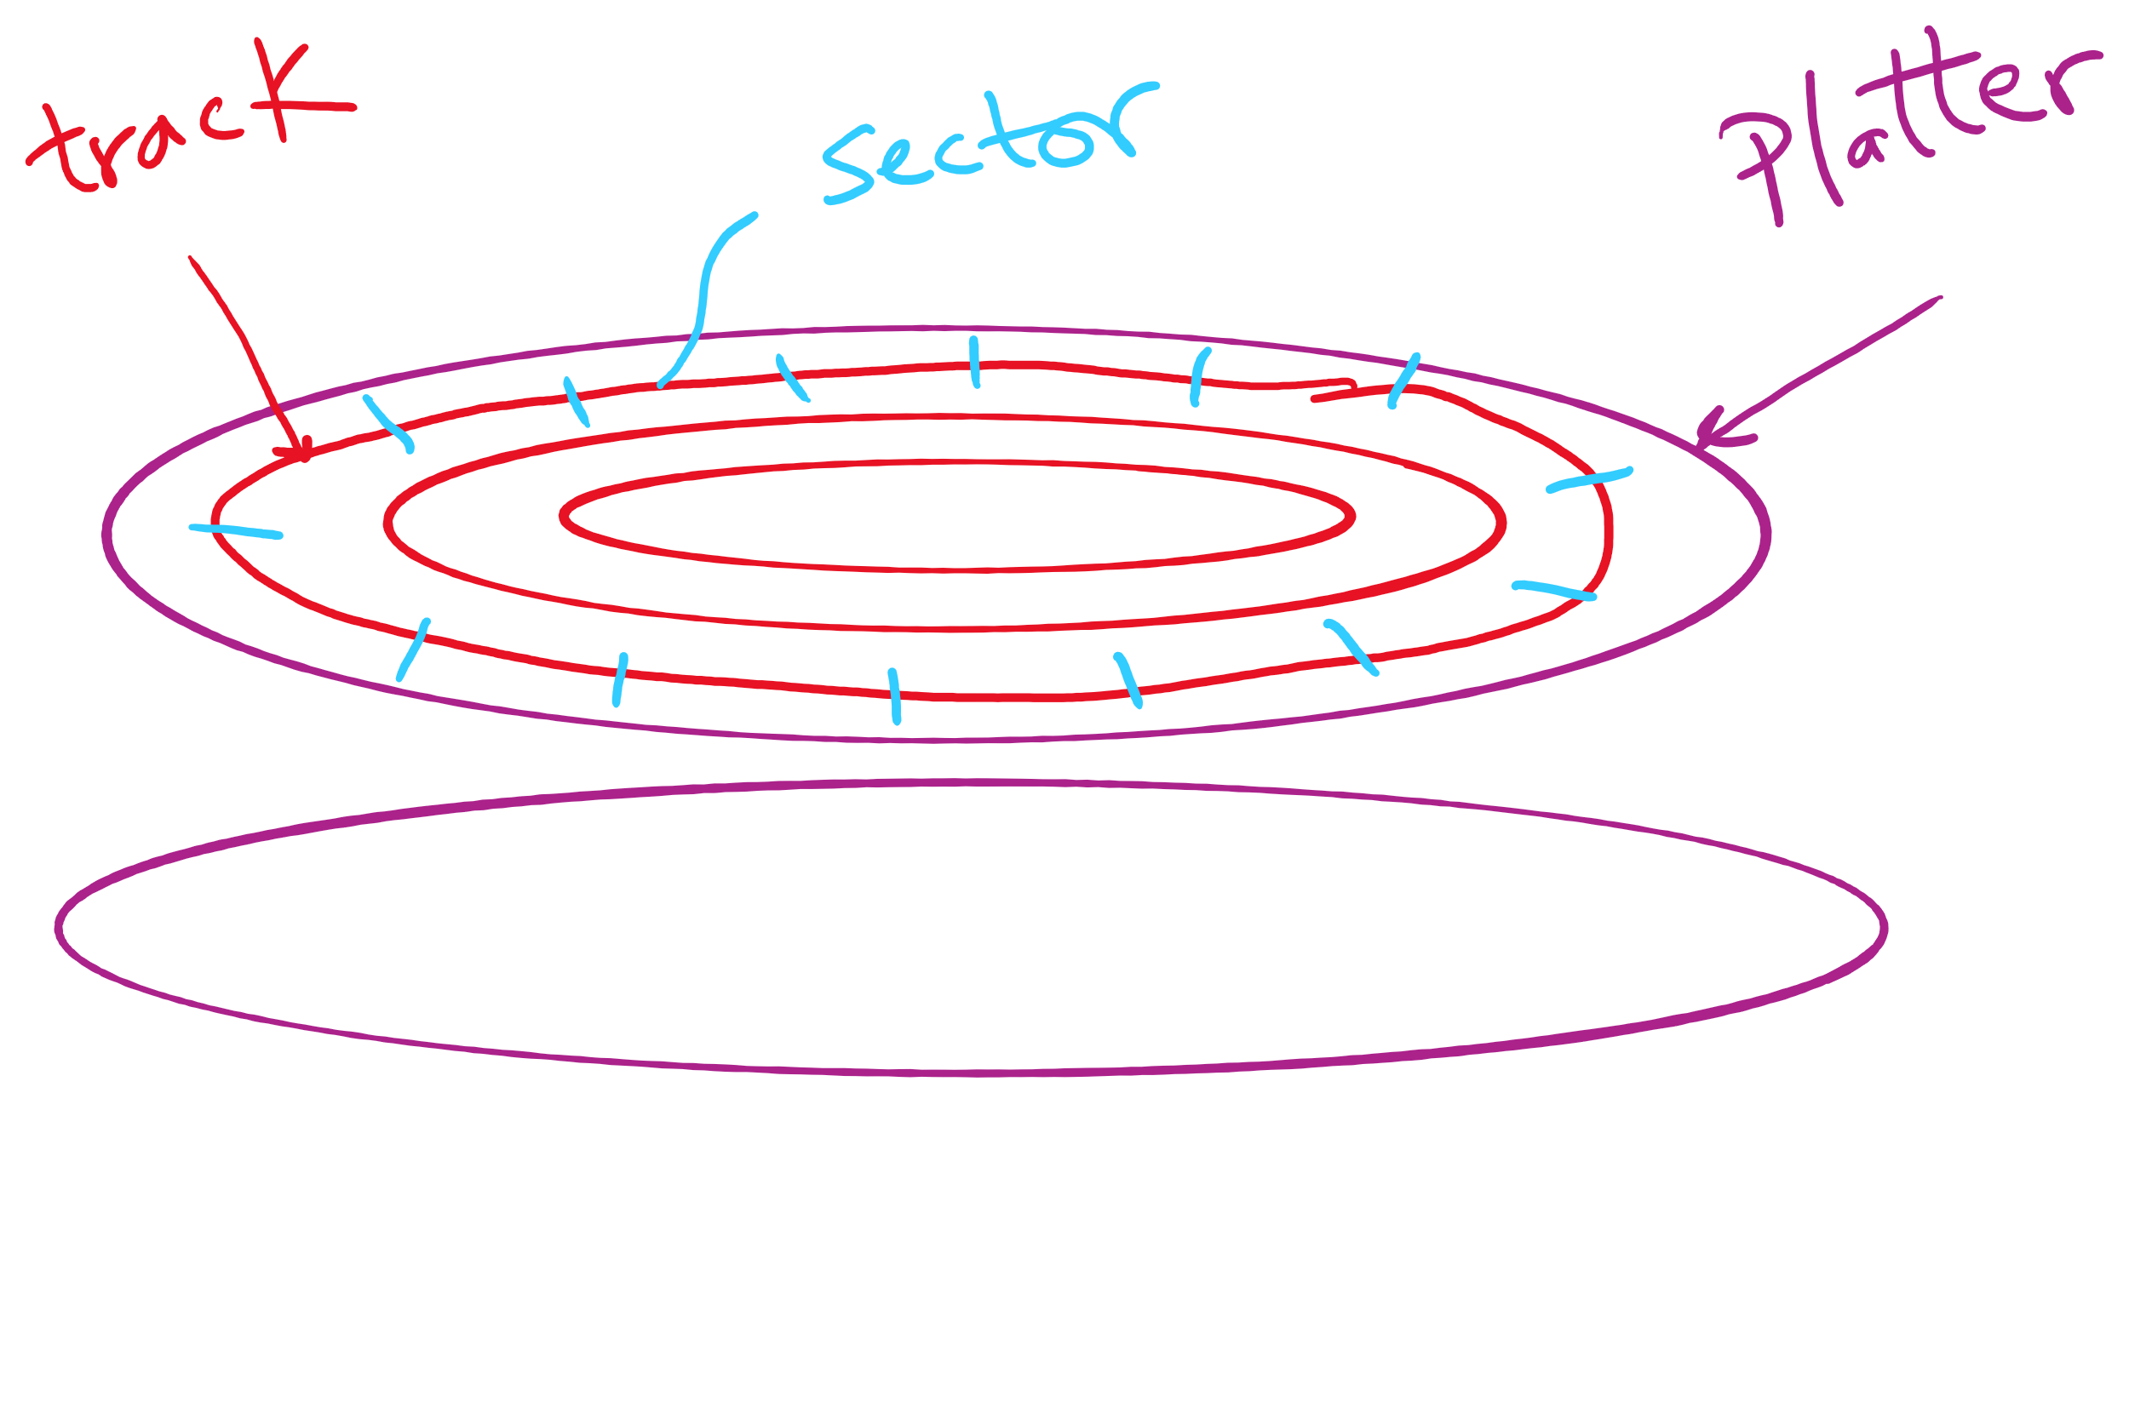
Disk Sector

Slide 43
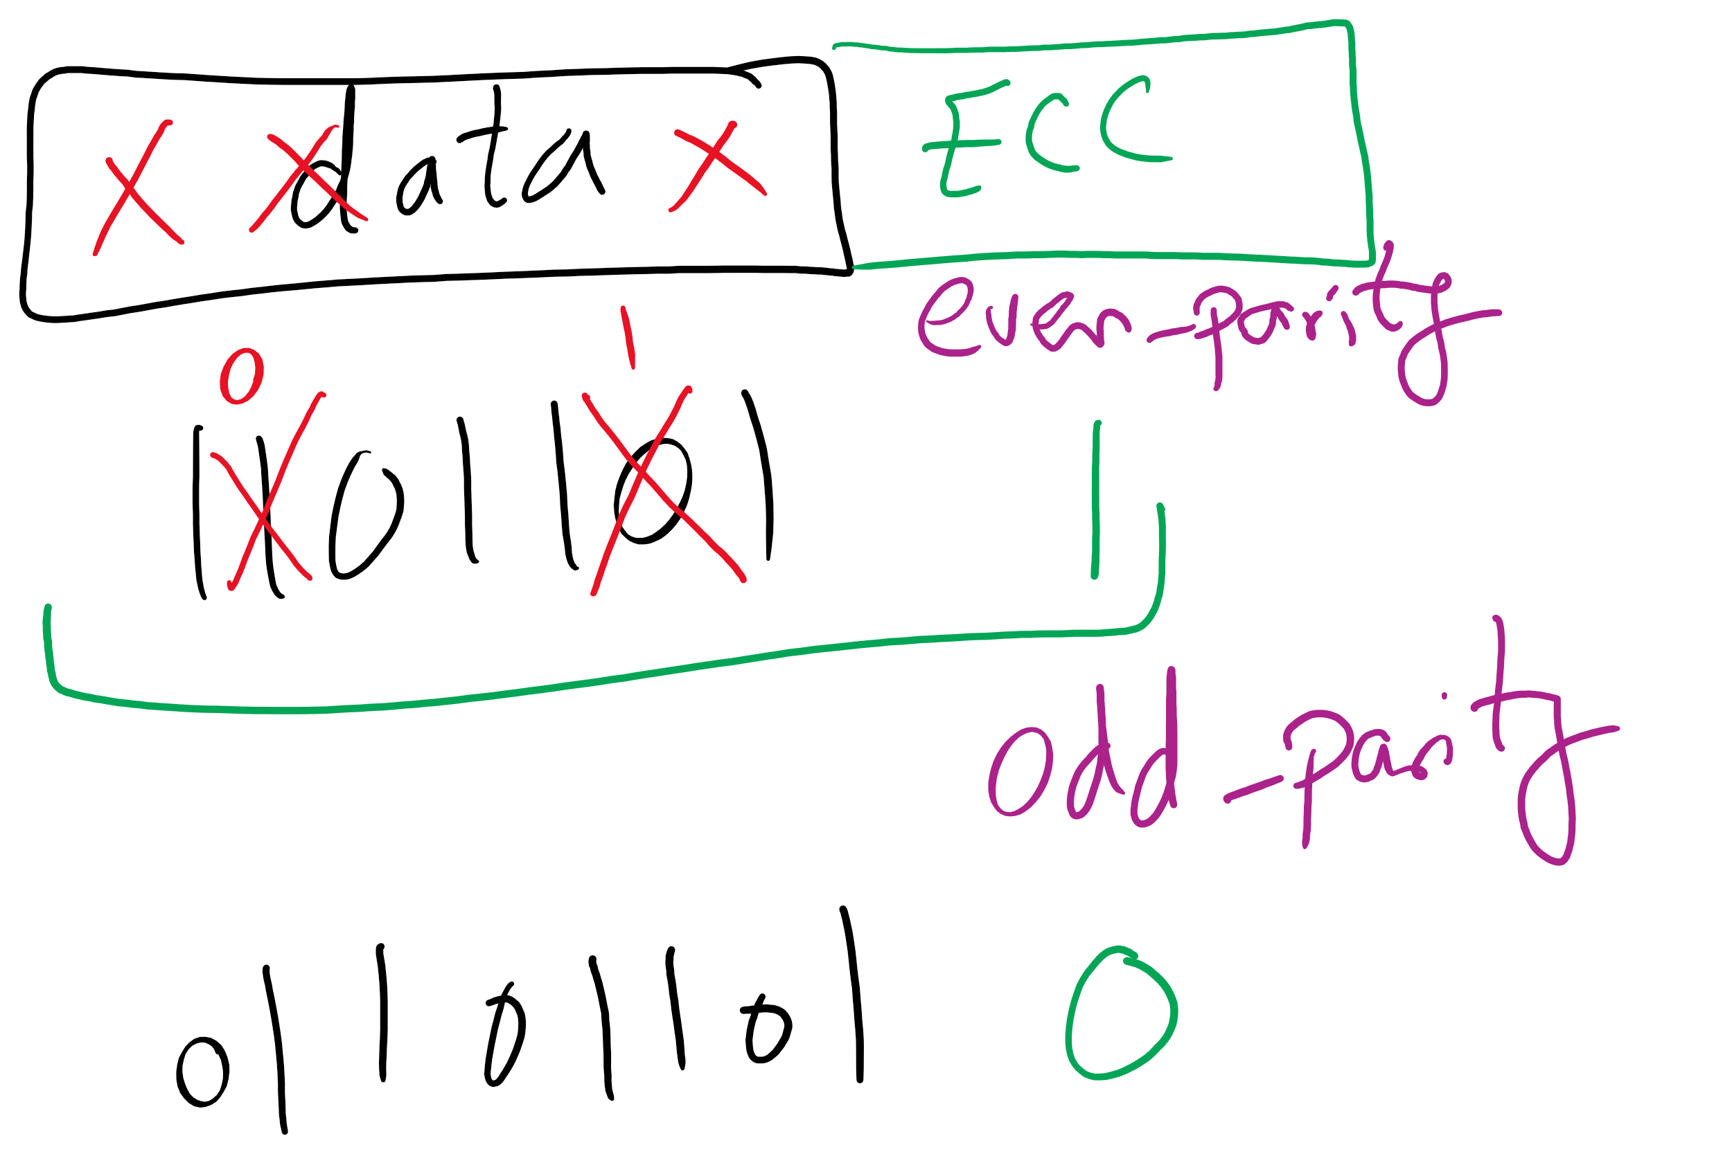
1-d parity

Slide 44
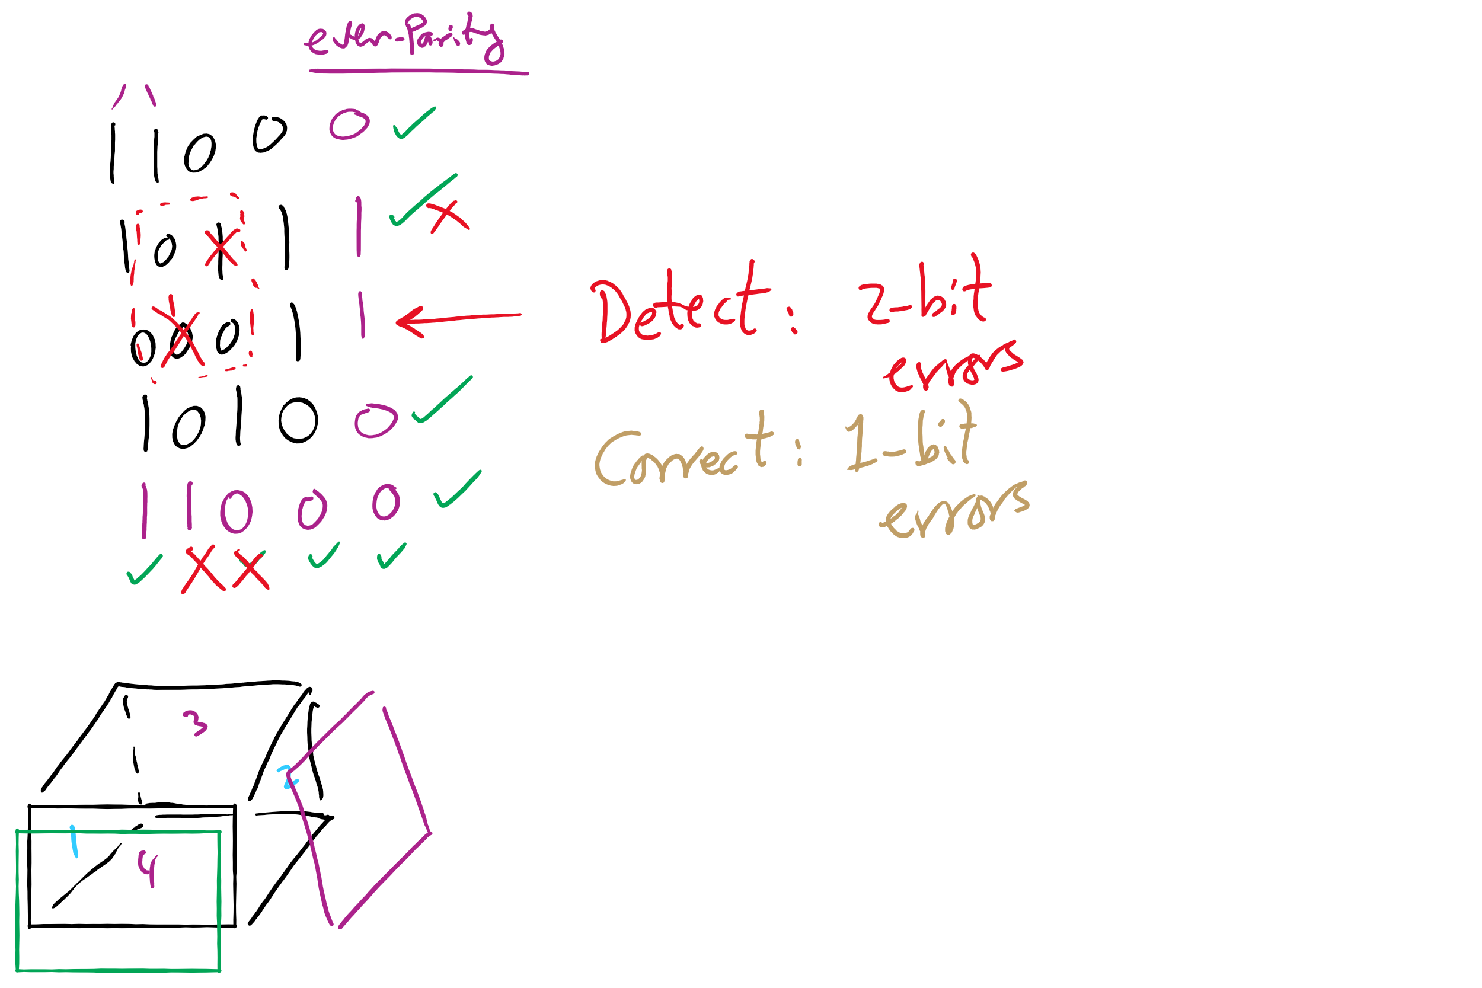
2-d parity

Slide 45
Sector Skew
Sectors numbered sequentially on each track
Numbering starts in different place on each track: sector skew
Allows time for switching head from track to track
All done to minimize delay in sequential transfers

Slide 46
File block cache data structures

Slide 47
Muddiest Points (3/3)
RAID
RAID 4 and 5
the different RAID levels
Can you elaborate on the disk failures needed for data to be lost in RAID 4
from lecture 21, calculating the size of a block
File system backups
using bitmaps to back up files
If an i-node has all the block numbers of a file, do you still need to traverse a file such as by iterating through the blocks' pointers in order to find data, or is that only for allocating new blocks?
What happens when a disk runs out of spare sectors? Is that the total disk failure?
Overarching Questions
How does the OS manage different techniques for disk quality
An overview of each concepts purpose that we went over today would be nice (RAID, sector skew, etc.)

Slide 48
RAIDs, RAIDs, and more RAIDs
Stripe
strip
strip
RAID 0
(Redundant Array of Inexpensive Disks
RAID 1
(Mirrored copies)
RAID 4
(Striped with parity)
RAID 5
(Parity rotates through disks)

Slide 49
Today’s Agenda …
File System Implementation
Optimizing performance
Low-level device driver issues

Slide 50
Sector interleaving
On older systems, the CPU was slow => time elapsed between reading consecutive sectors
Solution: leave space between consecutively numbered sectors
This isn’t done much these days…
7
0
7
0
5
0
6
1
3
4
2
3
5
2
6
1
7
6
4
3
2
5
4
1
No interleaving
Skipping 1 sector
Skipping 2 sectors

Slide 51
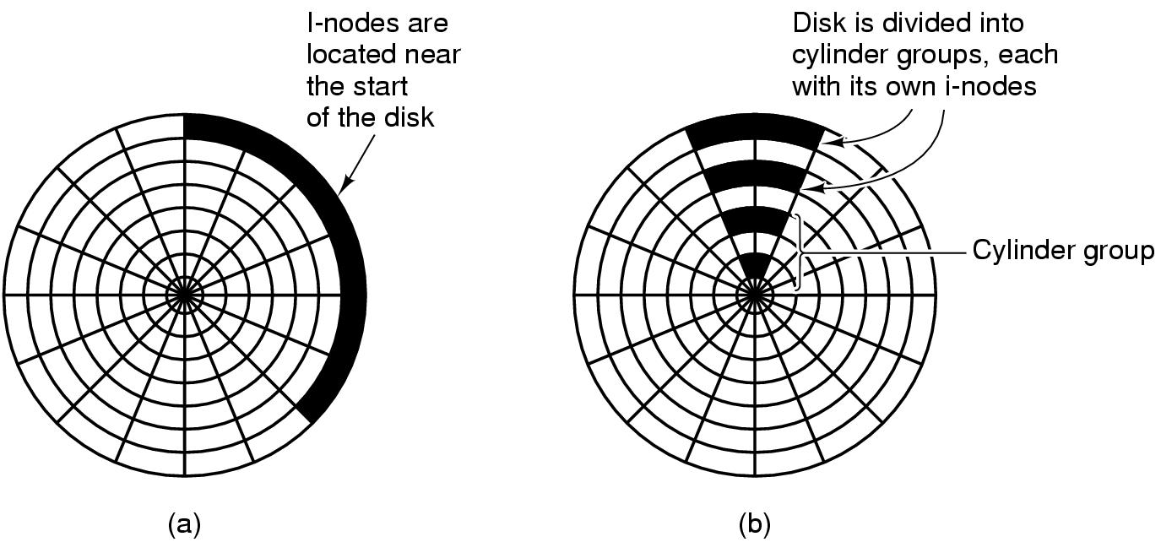
Grouping data on disk

Slide 52
Log-structured file systems
Trends in disk & memory
Faster CPUs
Larger memories
Result
More memory -> disk caches can also be larger
Increasing number of read requests can come from cache
Thus, most disk accesses will be writes
LFS structures entire disk as a log
All writes initially buffered in memory
Periodically write these to the end of the disk log
When file opened, locate i-node, then find blocks
Issue: what happens when blocks are deleted?

Slide 53
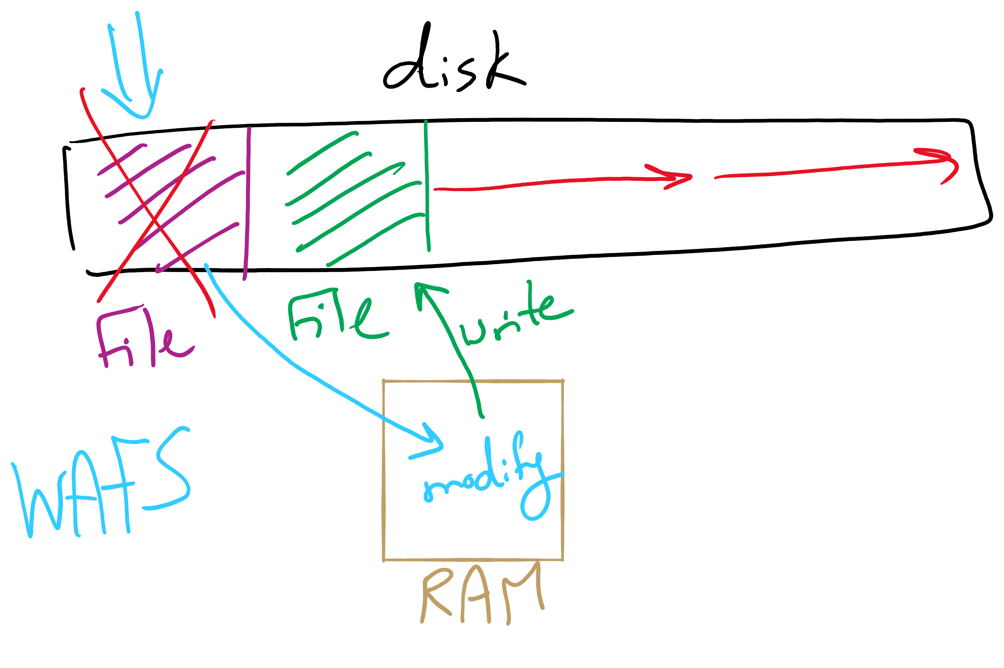
Log Structured File System

Slide 54
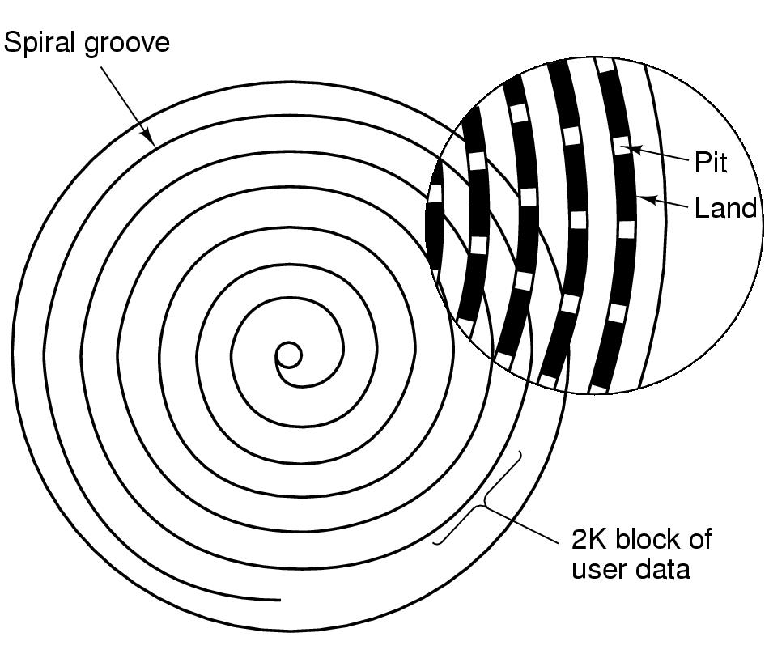
CD-ROM recording
CD-ROM has data in a spiral
Hard drives have concentric circles of data
One continuous track: just like vinyl records!
Pits & lands “simulated” with heat-sensitive material on CD-Rs and CD-RWs

Slide 55
Flash File System
Wear Leveling
Count total writes per flash sector and attempt to balance across the whole disk

Slide 56
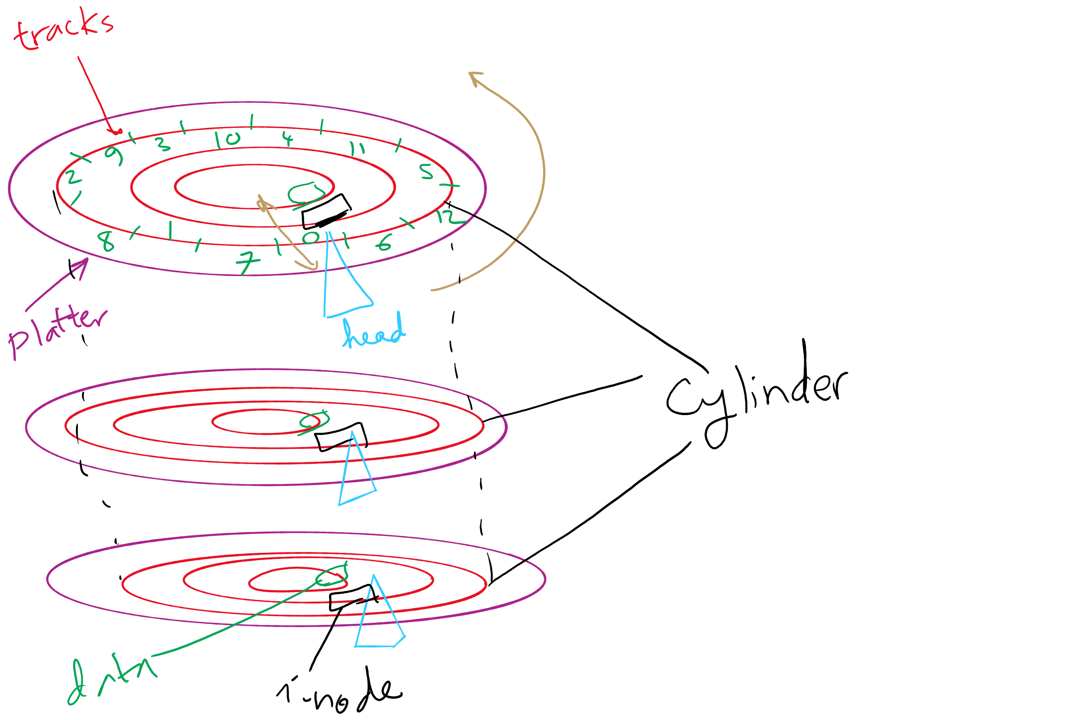
Disks, cylinders, cylinder groups

Slide 57
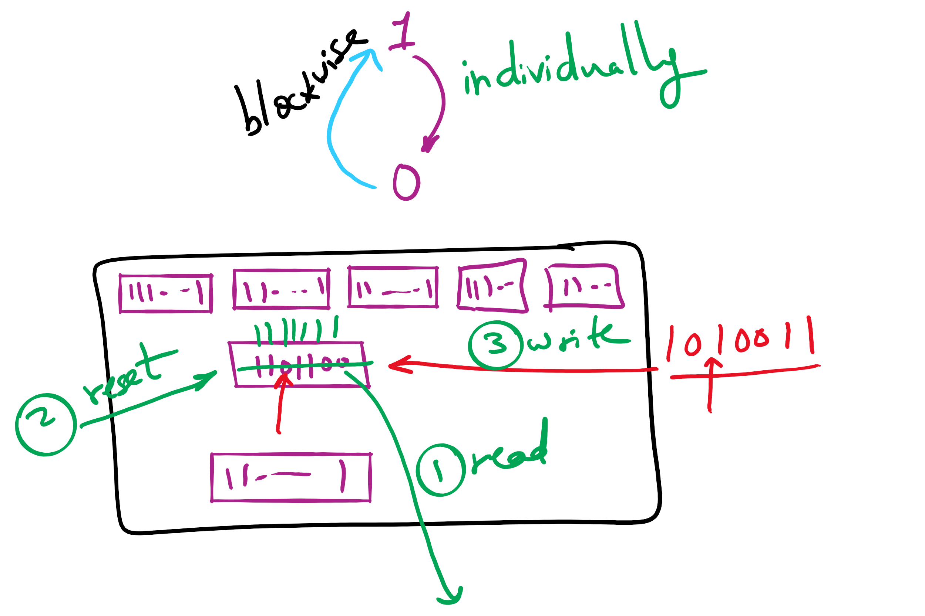
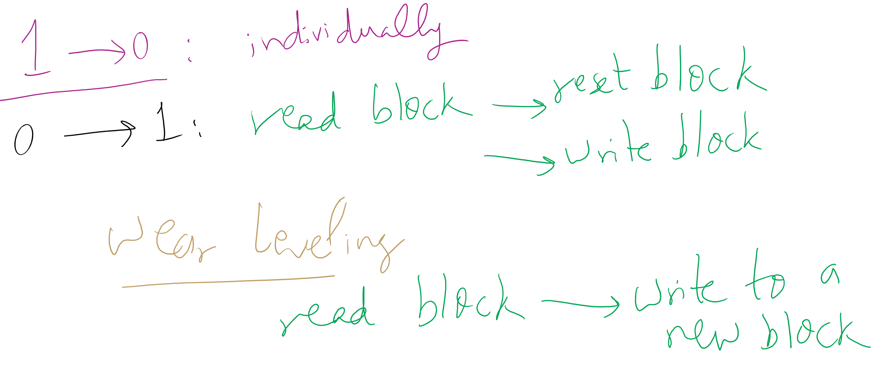
Wear leveling for SSDs

Slide 58
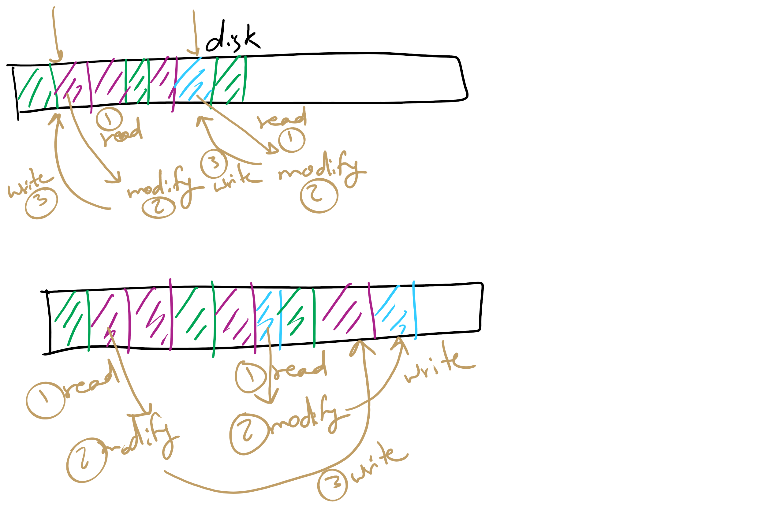
Log Structured File System

Slide 59
Today’s Agenda …
Low-level device driver issues
memory-mapped vs port-mapped I/O
3 Ways to read/write from an I/O Device
Disk structure and scheduling

Slide 60
Grouping data on disk

Slide 61
Log-structured file systems
Trends in disk & memory
Faster CPUs
Larger memories
Result
More memory -> disk caches can also be larger
Increasing number of read requests can come from cache
Thus, most disk accesses will be writes
LFS structures entire disk as a log
All writes initially buffered in memory
Periodically write these to the end of the disk log
When file opened, locate i-node, then find blocks
Issue: what happens when blocks are deleted?

Slide 62
CD-ROM recording
CD-ROM has data in a spiral
Hard drives have concentric circles of data
One continuous track: just like vinyl records!
Pits & lands “simulated” with heat-sensitive material on CD-Rs and CD-RWs

Slide 63
Flash File System
Wear Leveling
Count total writes per flash sector and attempt to balance across the whole disk

Slide 64
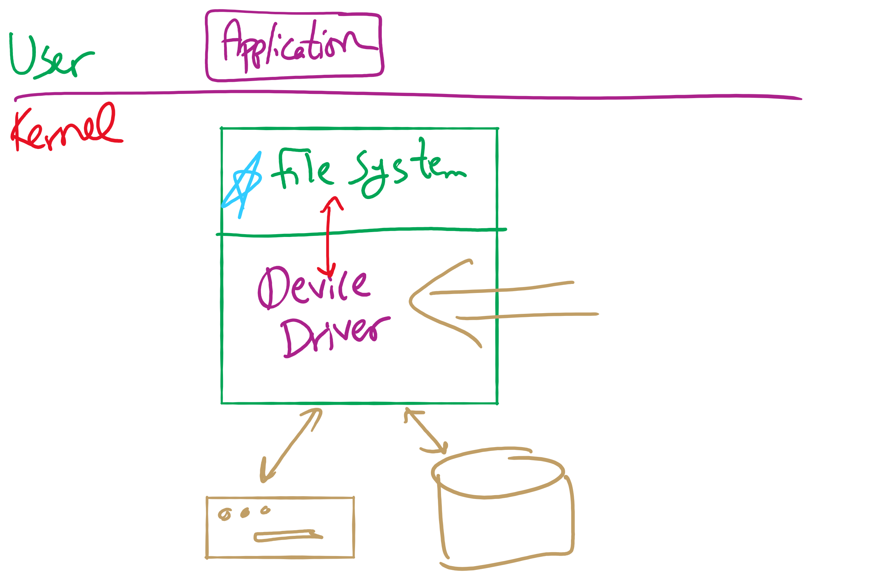
Software Stack

Slide 65
Device drivers
Device drivers go between device controllers and rest of OS
Drivers standardize interface to widely varied devices
Device drivers communicate with controllers over bus
Controllers communicate with devices themselves
User space
User program
Kernel space
Rest of the OS
Keyboard driver
Disk driver
Keyboard controller
Disk controller

Slide 66
How are I/O devices connected?
Single-bus
All memory accesses go over a shared bus
I/O and RAM accesses compete for bandwidth
Dual-bus
RAM access over high-speed bus
I/O access over lower-speed bus
Less competition
More hardware (more expensive…)
CPU
Memory
I/O
CPU
Memory
I/O
This port allows I/O devices access into memory

Slide 67
Device controllers
Electronic component controls the device
May be able to handle multiple devices
May be more than one controller per mechanical component (example: hard drive)
Controller's tasks
Convert serial bit stream to block of bytes
Perform error correction as necessary
Make available to main memory
Block Devices
A device that stores data in fixed‐sized blocks, each uniquely addressed, and can be randomly accessed
Character Devices
Device that delivers or accepts a stream of characters

Slide 68
Layers of I/O software
User-level I/O software & libraries
User
Device-independent OS software
Operating system (kernel)
Device drivers
Interrupt handlers
Hardware

Slide 69
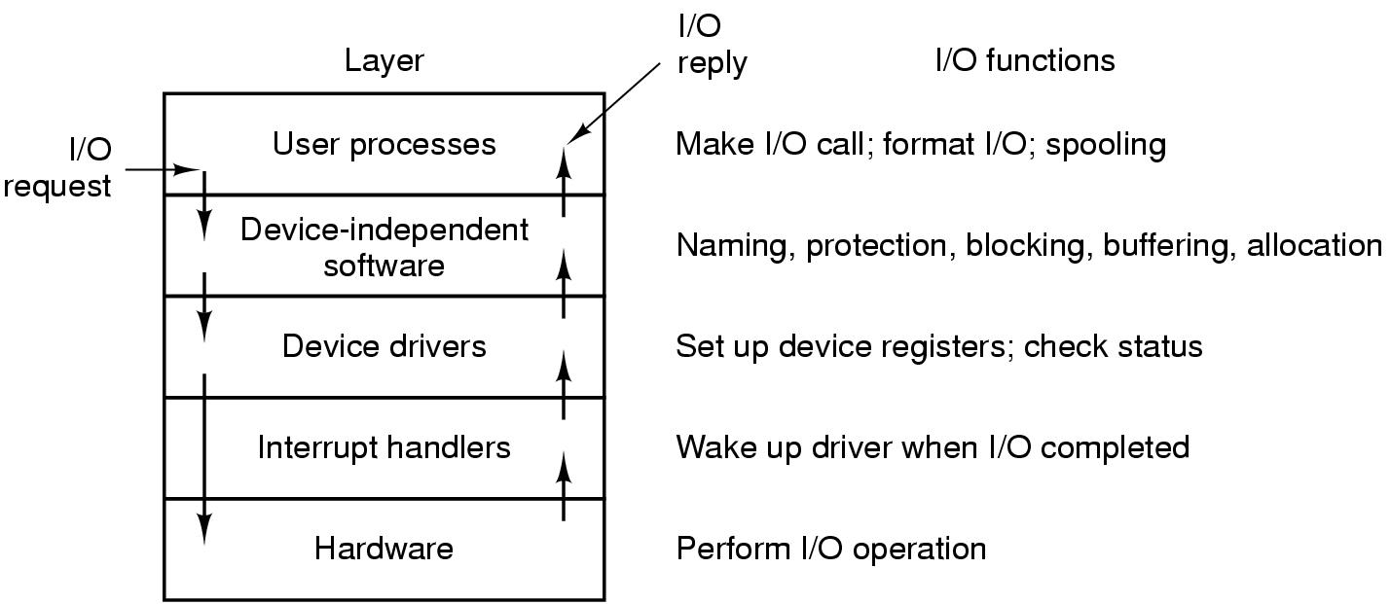
Anatomy of an I/O request

Slide 70
Device Driver goals
Device independence
Programs can access any I/O device
No need to specify device in advance
Uniform naming
Name of a file or device is a string or an integer
Doesn’t depend on the machine (underlying hardware)
Error handling
Done as close to the hardware as possible
Isolate from higher-level software
Synchronous vs. asynchronous transfers
Blocked transfers vs. interrupt-driven
Buffering
Data coming off a device cannot be stored in final destination
Sharable vs. dedicated devices

Slide 71
Memory-Mapped vs. separate I/O Space
Memory
0xFFF…
I/O ports
0
Separate I/O & memory space
Memory-mapped I/O
Hybrid: both memory-mapped & separate spaces

Slide 72
Example: Dynamic Frequency on XScale

Slide 73
Programmed I/O example: printing a page
User
Printed page
Printed page
Printed page
ABCD EFGH
ABCD EFGH
ABCD EFGH
A
AB
Kernel
ABCD EFGH
ABCD EFGH

Slide 74
Polling
copy_from_user (buffer, p, count); // copy into kernel buffer
for (j = 0; j < count; j++) { // loop for each char
while (*printer_status_reg != READY)
; // wait for printer to be ready
*printer_data_reg = p[j]; // output a single character
}
return_to_user();

Slide 75
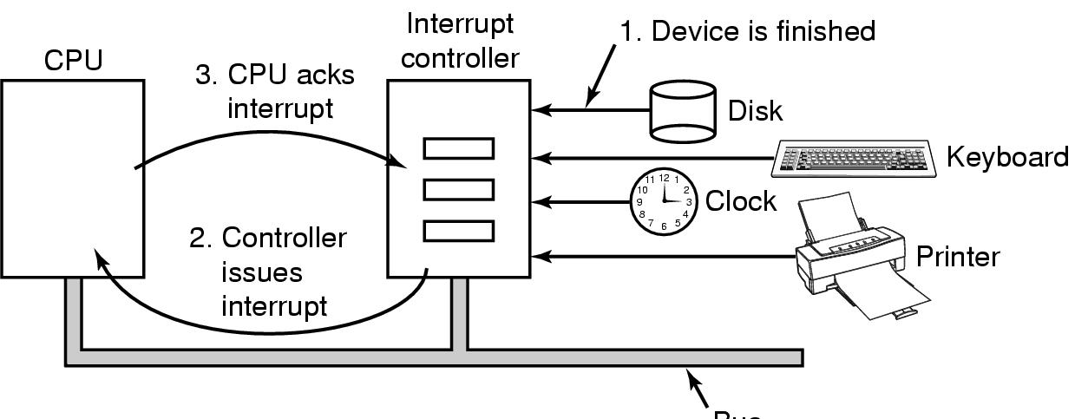
Hardware’s view of interrupts
Bus

Slide 76
Interrupt-driven I/O
copy_from_user (buffer, p, count);
j = 0;
enable_interrupts();
while (*printer_status_reg != READY)
;
*printer_data_reg = p[0];
scheduler(); // and block user
Code run by system call
if (count == 0) {
unblock_user();
} else {
j++;
*printer_data_reg = p[j];
count--;
}
acknowledge_interrupt();
return_from_interrupt();
Code run at interrupt time
(Interrupt handler)

Slide 77
What happens on an interrupt
Set up stack for interrupt service procedure
Ack interrupt controller, reenable interrupts
Copy registers from where saved
Run service procedure
(optional) Pick a new process to run next
Set up MMU context for process to run next
Load new process' registers
Start running the new process

Slide 78
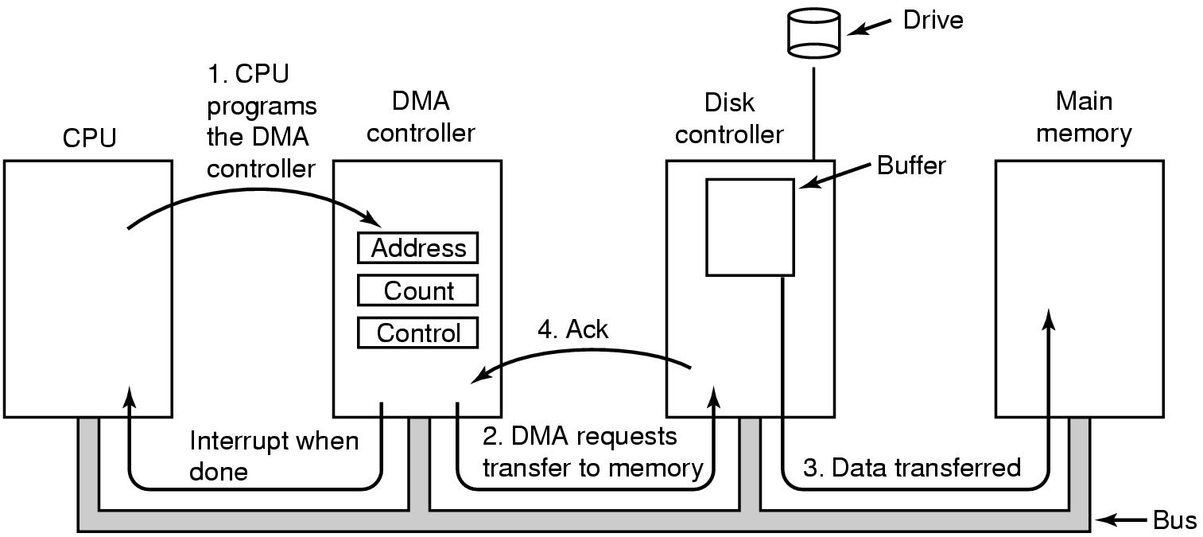
Direct Memory Access (DMA) operation

Slide 79
I/O using DMA
copy_from_user (buffer, p, count);
set_up_DMA_controller();
scheduler(); // and block user
Code run by system call
acknowledge_interrupt();
unblock_user();
return_from_interrupt();
Code run at interrupt time

Slide 80
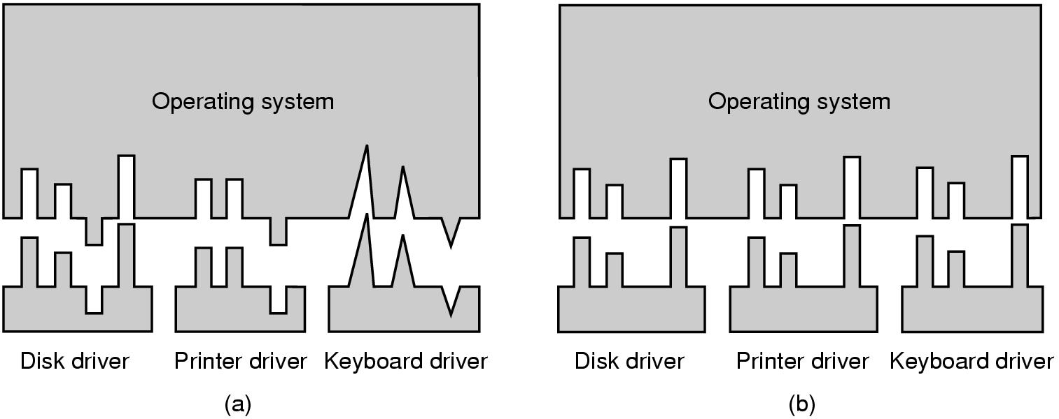
Why a standard driver interface?
Non-standard driver interfaces
Standard driver interfaces

Slide 81
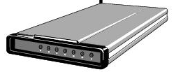
Buffering device input
User space
User space
User space
User space
Kernel space
Kernel space
Kernel space
Kernel space
2
2
1
1
3
Unbuffered input
Buffering in user space
Buffer in kernel Copy to user space
Double buffer in kernel

Slide 82
Disk drive structure
Data stored on surfaces
Up to two surfaces per platter
One or more platters per disk
Data in concentric tracks
Tracks broken into sectors
256B-1KB per sector
Cylinder: corresponding tracks on all surfaces
Data read and written by heads
Actuator moves heads
Heads move in unison
head
sector
platter
track
cylinder
surfaces
spindle
actuator

Slide 83
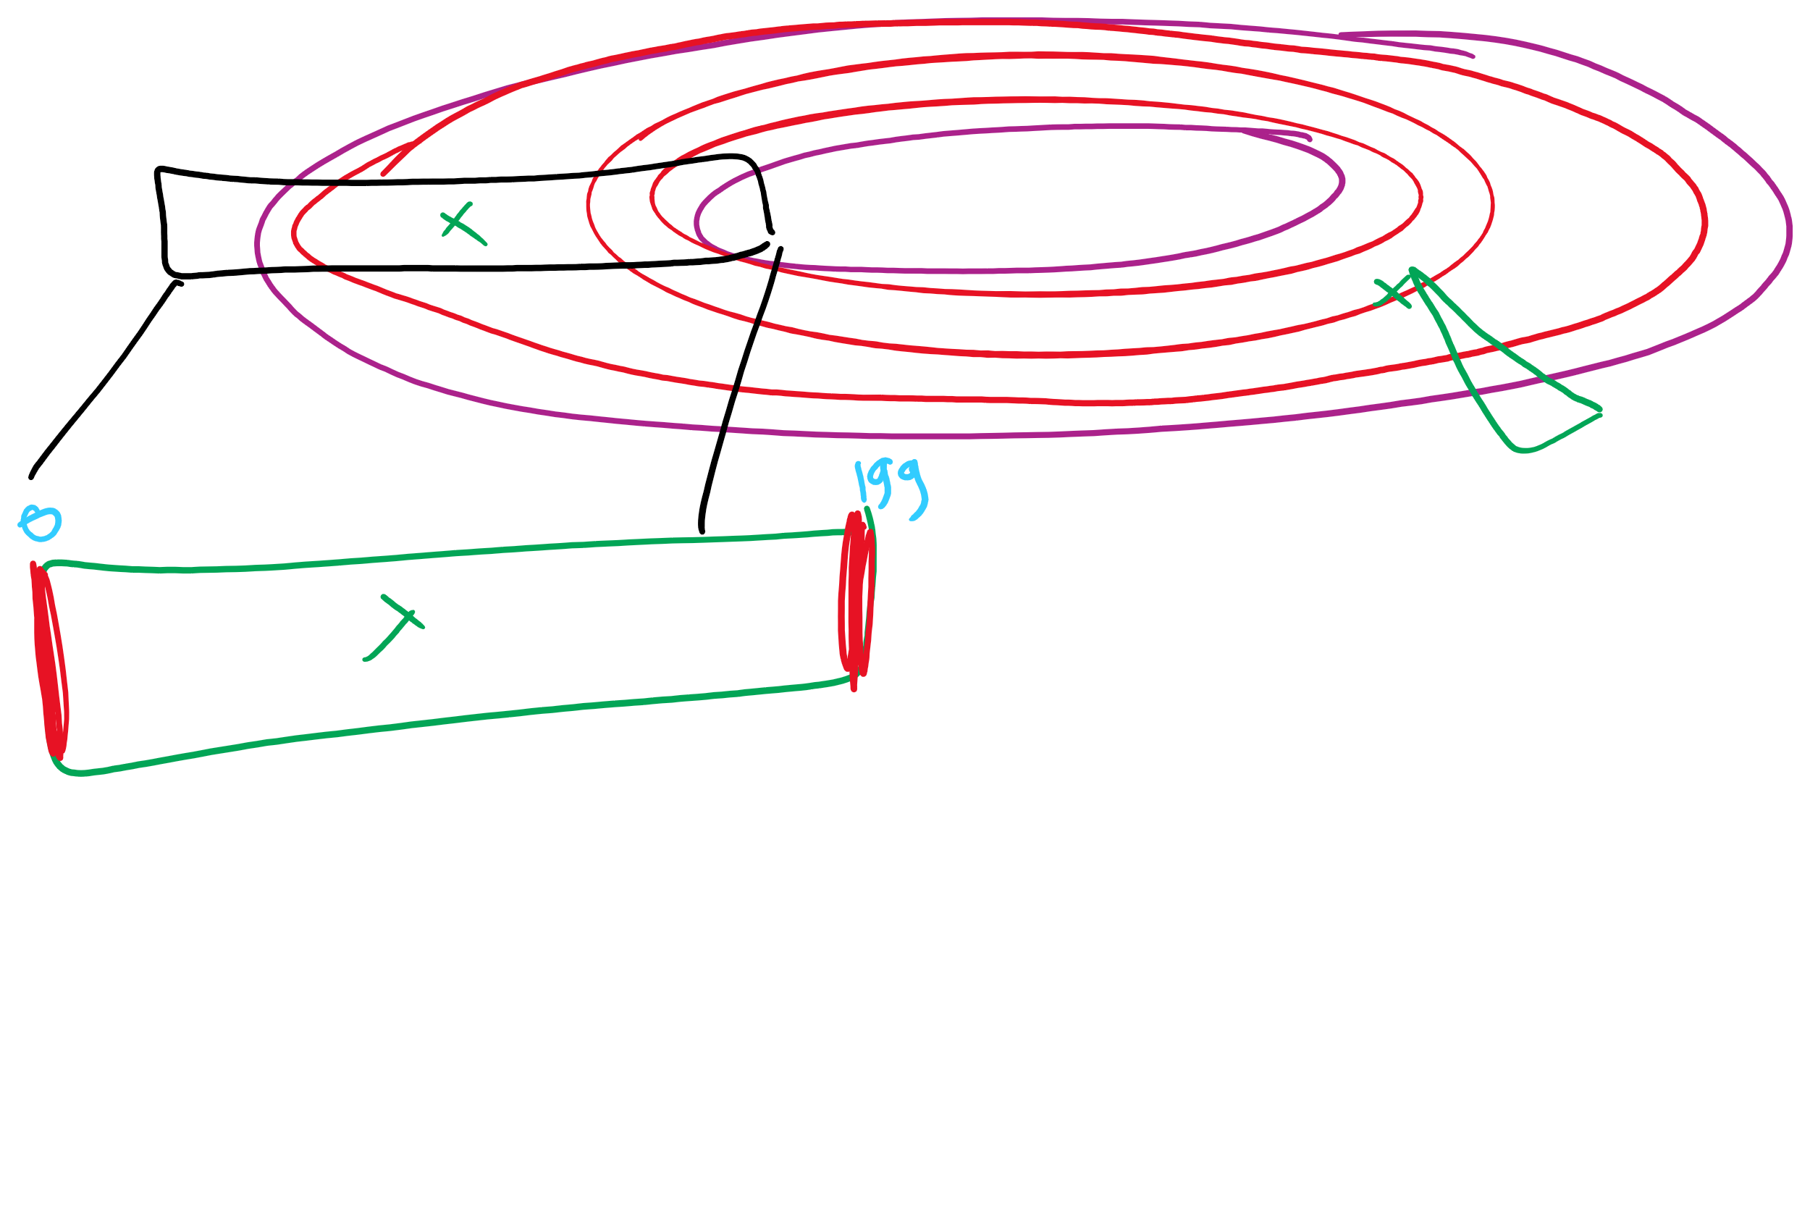
Disk scheduling algorithms
Schedule disk requests to minimize disk seek time
Seek time increases as distance increases (though not linearly)
Minimize seek distance -> minimize seek time
Disk seek algorithm examples assume a request queue & head position (disk has 200 cylinders)
Queue = 100, 175, 51, 133, 8, 140, 73, 77
Head position = 63
Outside edge
Inside edge
8
51
73
100
133
175
77
140
read/write head position
disk requests
(cylinder in which block resides)

Slide 84
First-Come-First Served (FCFS)
Requests serviced in the order in which they arrived
Easy to implement!
May involve lots of unnecessary seek distance
Seek order = 100, 175, 51, 133, 8, 140, 73, 77
Seek distance = (100-63) + (175-100) + (175-51) + (133-51) + (133-8) + (140-8) + (140-73) + (77-73) = 646 cylinders
read/write head start
100
175
51
133
8
140
73
77

Slide 85
Shortest Seek Time First (SSTF)
Service the request with the shortest seek time from the current head position
Form of SJF scheduling
May starve some requests
Seek order = 73, 77, 100, 133, 140, 175, 51, 8
Seek distance = 10 + 4 + 23 + 33 + 7 + 35 + 124 + 43 = 279 cylinders
read/write head start
73
77
51
8
133
100
140
175

Slide 86
SCAN (elevator algorithm)
Disk arm starts at one end of the disk and moves towards the other end, servicing requests as it goes
Reverses direction when it gets to end of the disk
Also known as elevator algorithm
Seek order = 51, 8, 0 , 73, 77, 100, 133, 140, 175
Seek distance = 12 + 43 + 8 + 73 + 4 + 23 + 33 + 7 + 35 = 238 cyls
read/write head start
51
8
73
77
100
133
140
175

Slide 87
C-SCAN
Identical to SCAN, except head returns to cylinder 0 when it reaches the end of the disk
Treats cylinder list as a circular list that wraps around the disk
Waiting time is more uniform for cylinders near the edge of the disk
Seek order = 73, 77, 100, 133, 140, 175, 199, 0, 8, 51
Distance = 10 + 4 + 23 + 33 + 7 + 35 + 24 + 199 + 8 + 43 = 386 cyls
read/write head start
73
77
100
133
140
175
8
51

Slide 88
C-LOOK
Identical to C-SCAN, except head only travels as far as the last request in each direction
Saves seek time from last sector to end of disk
Seek order = 73, 77, 100, 133, 140, 175, 8, 51
Distance = 10 + 4 + 23 + 33 + 7 + 35 + 167 + 43 = 322 cylinders
read/write head start
73
77
100
133
140
175
8
51

